Slide 1
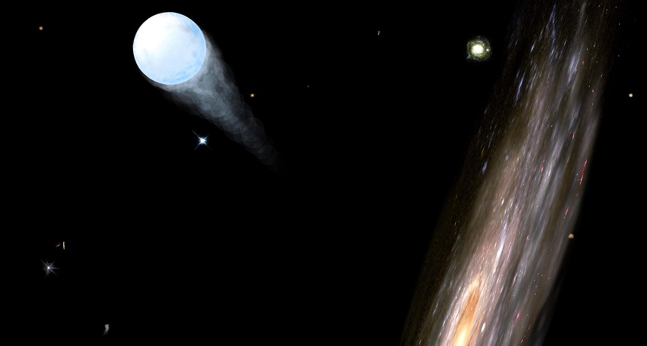
Main Sequence Runaway Project
Ondrejov Observatory (22.08.2023)
Aakash Bhat

Slide 2
Content
Intro: What are Runaways
Theory: Why are Runaways
Observations: Where are Runaways

Slide 3
What are Runaways and why are they interesting?
Runaway stars are stars classified based on their „ejection“ or „space“ velocities
Multiple ejection populations
$v_{s}>30 km/s$ (Runaways)
$v_{esc}{>v}_{s}≫30 km/s$ (Hyper-runaways)
$v_{s}>v_{esc}$ (Hyper-velocity stars)
Multiple type populations
MS O,B,A..
sdOB (US708)
White Dwarfs as Type Ia remnants
White Dwarfs as Type Iax remnant
Compact objects show higher space velocities

Slide 4
Where are Runaways?
The motions of stars can be characterized with multiple components:
Stars rotate around the center of the Galaxy in a disk. This is where star formation takes place (rotation velocities of order 100-250 km/s)
Stars are born in open clusters. Think Pleiades, Orion.
Stars have a velocity dispersion within their clusters (of order <5 km/s)
So what happens if you find young stars outside the Milky Way disk going away from it?
Formed in the Disk and kicked out (Remember this for later)

Slide 5
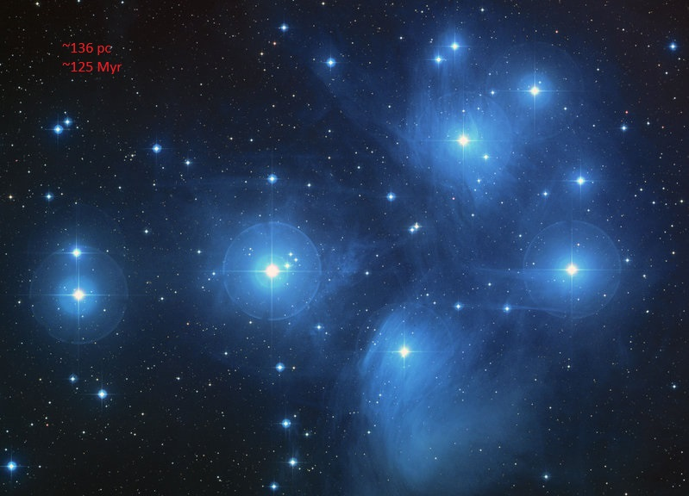
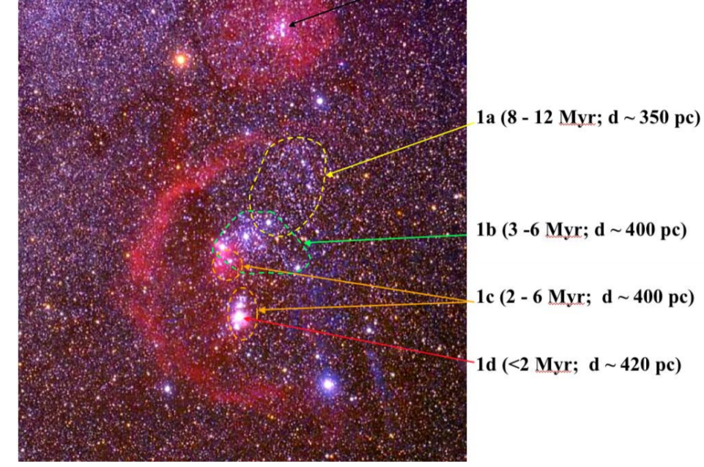
Formation Mechanism: Open Clusters/Associations
All Stars formed in clusters. Single, Binary, Triples..
Proto-clusters are violent. Many stars taking part in dynamics.
Gravitationally stable structure formed, but has there been mass loss?
Space Telescope Science Institute using HST
Bally J.
Overview of the Orion Complex (2008)

Slide 6
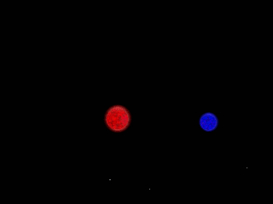
BSS: Binary Supernova Scenario
Credit: Andreas Irrgang

Slide 7
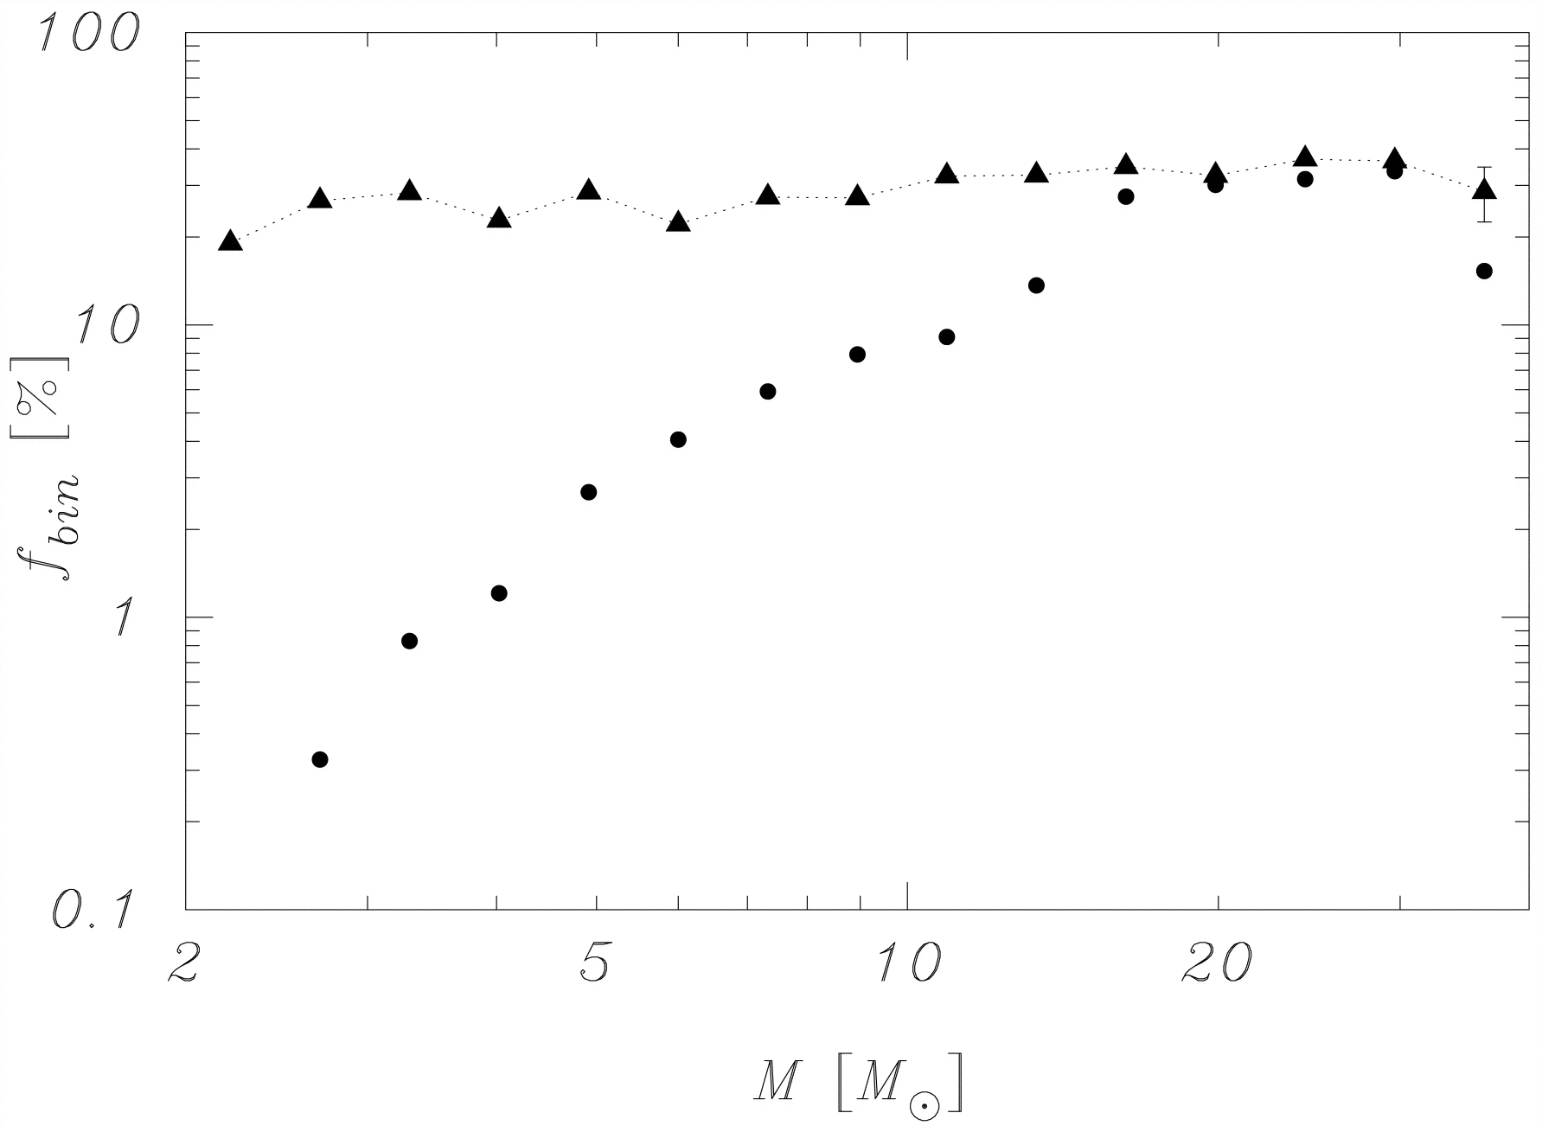
Binaries surviving supernovas
Mainly single!
Binary fraction of runaways
PORTEGIES ZWART (2000)

Slide 8
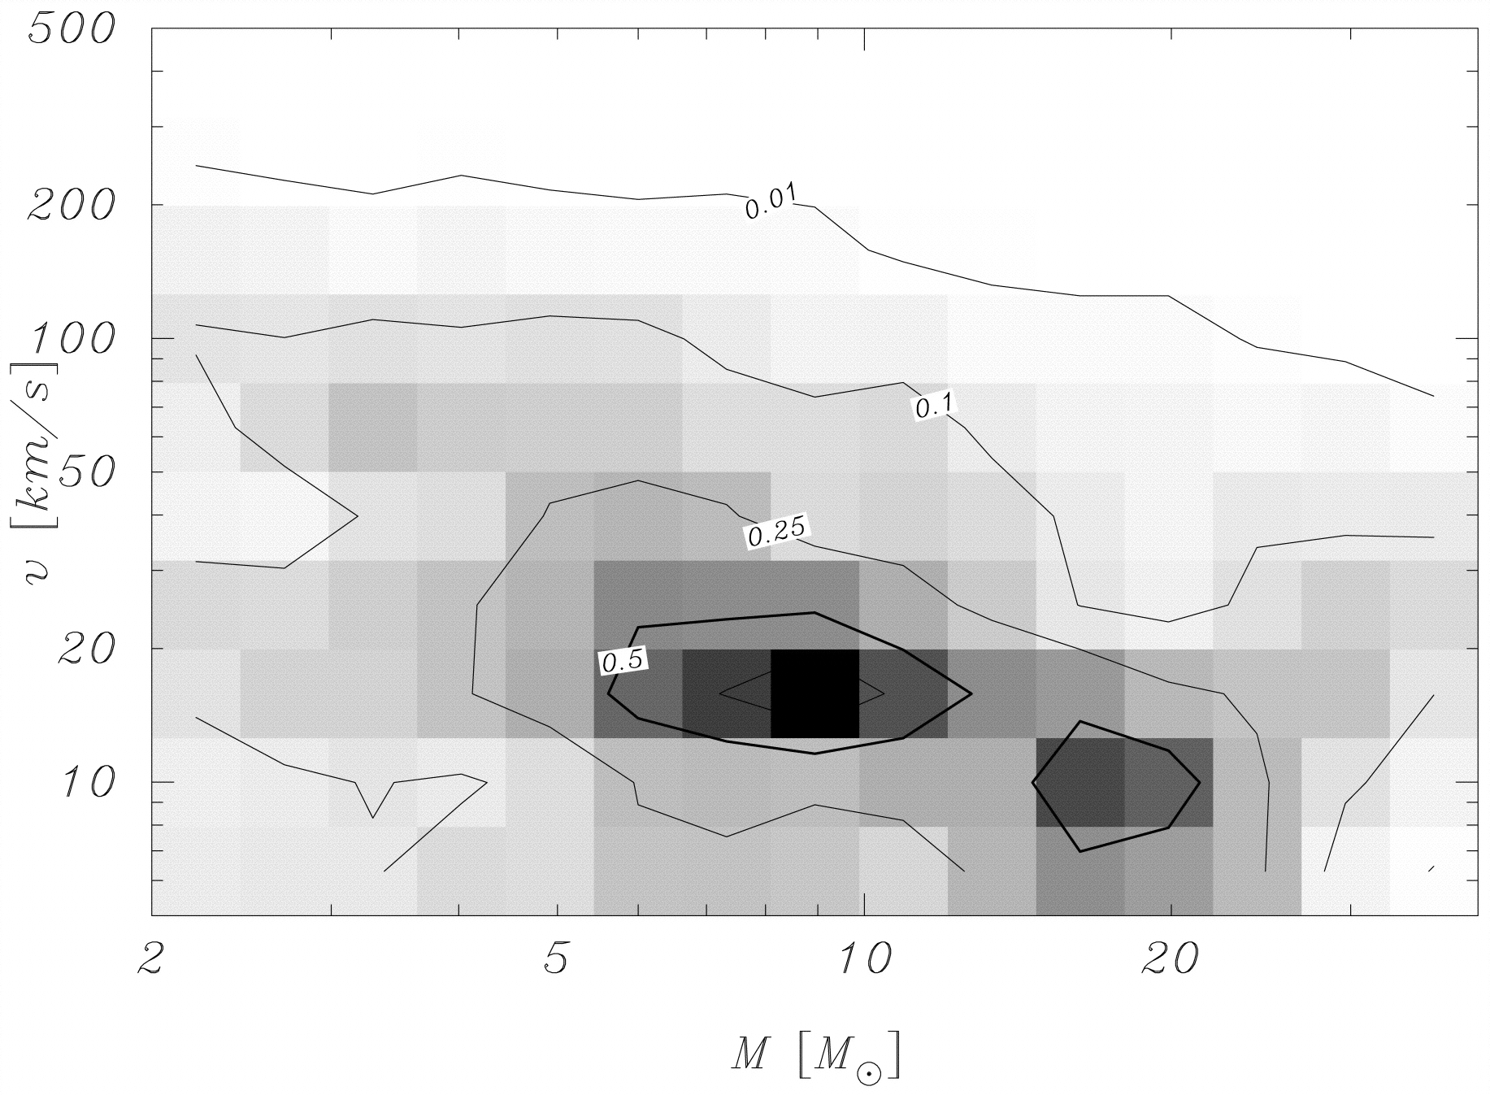

Slide 9
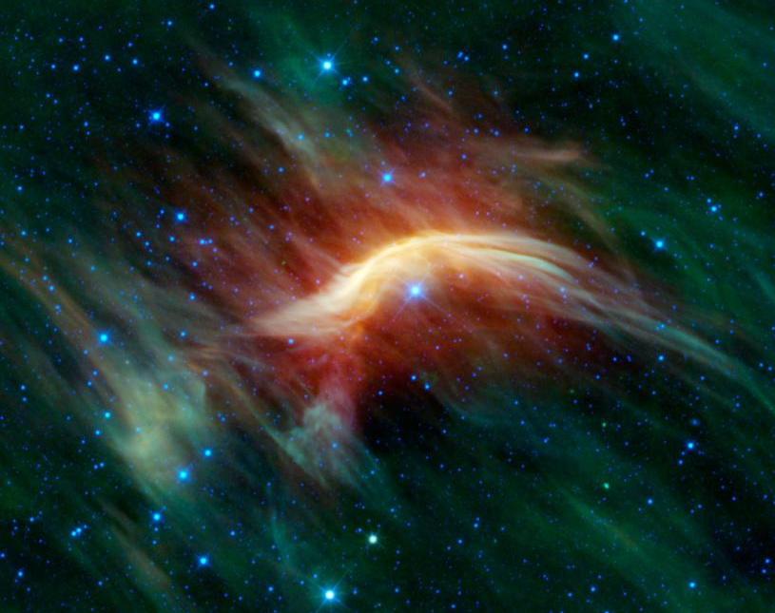
Zeta Ophiuchi
Credits: NASA

Slide 10
DES: Dynamical Ejection
Exchange
2 Runaways
1 Runaway

Slide 11
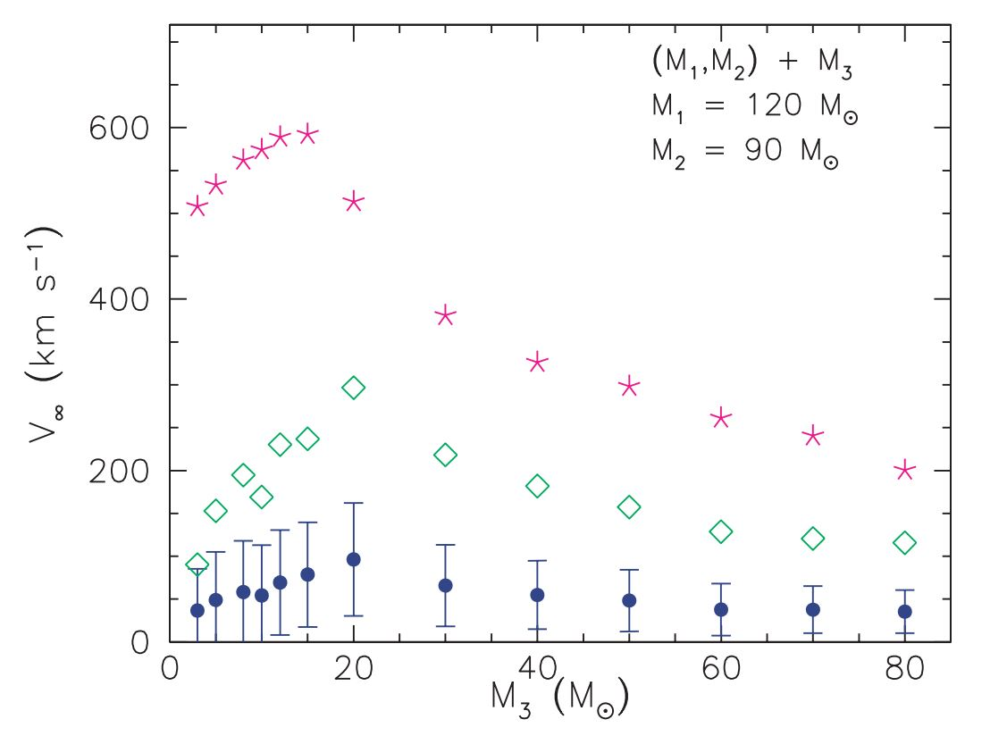
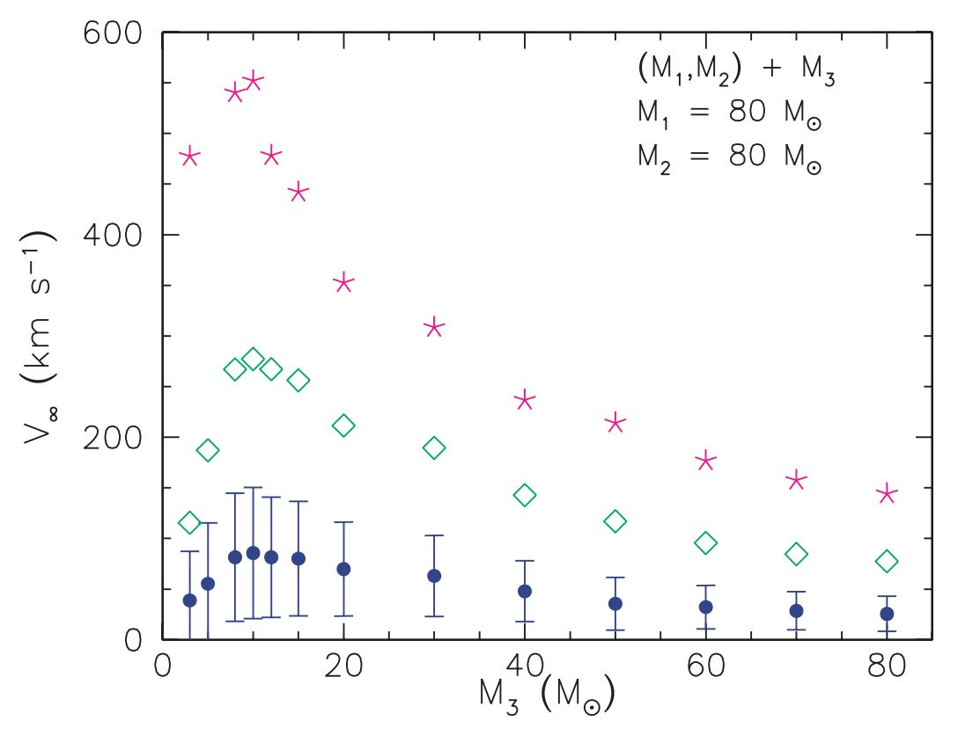
Gvaramadze et. Al.
The more massive the intruding star the greater its ability to affect the binding energy of the binary system and thereby to increase the kinetic energy of the system
The more massive the intruding star the larger the recoil velocity of the binary and the smaller the velocity of the ejected star relative to the centre of mass

Slide 12
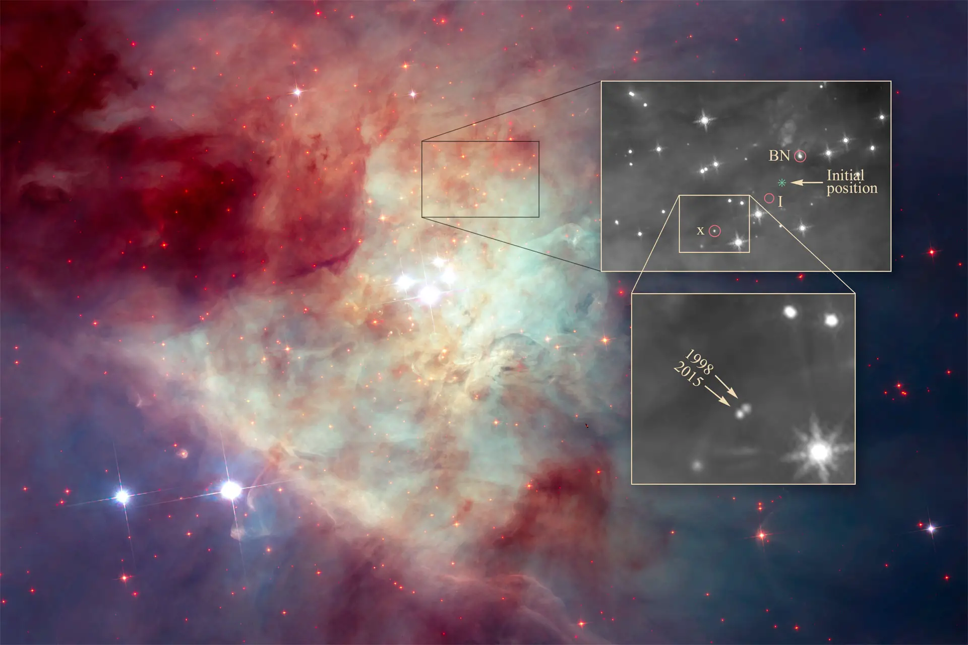
Credit: HST

Slide 13
Hills Mechanism: SMBH

Slide 14
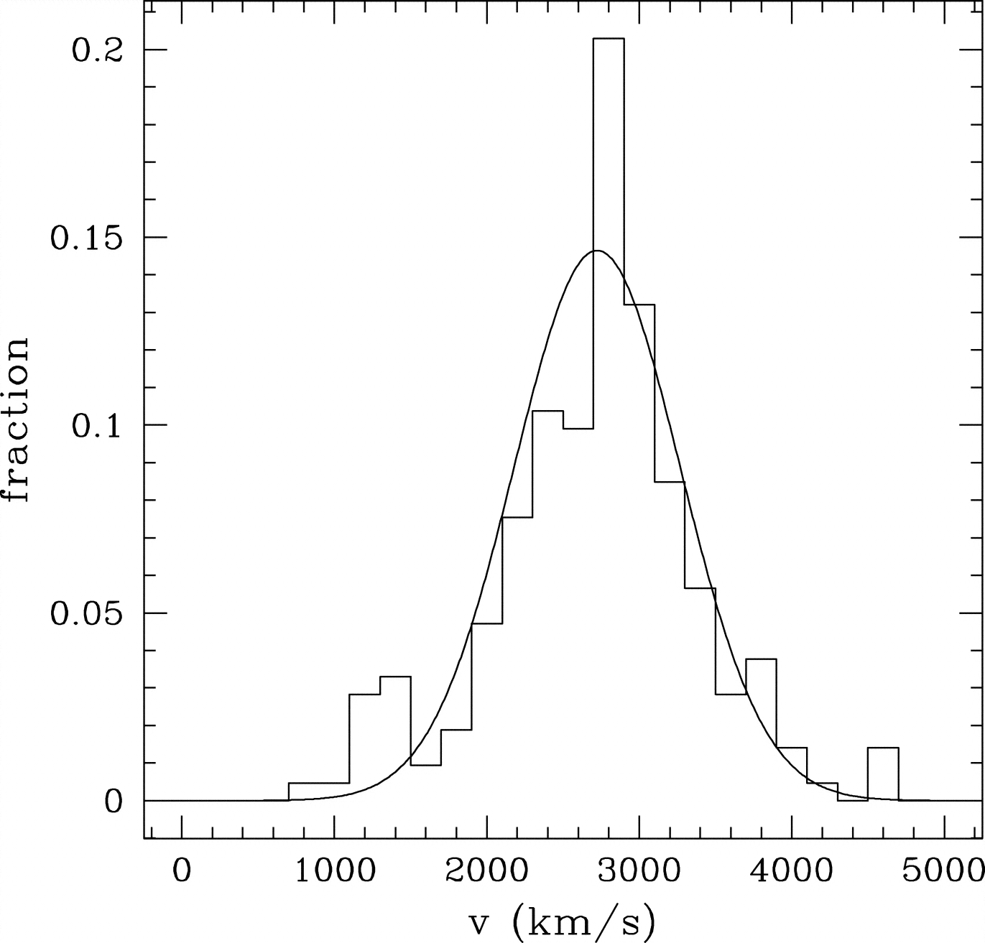
Hills Mechanism: SMBH
The Milky Way has an SMBH at its center
Binary goes near the SMBH
Tidal Forces disrupt the binary
Hypervel + S-type

Slide 15
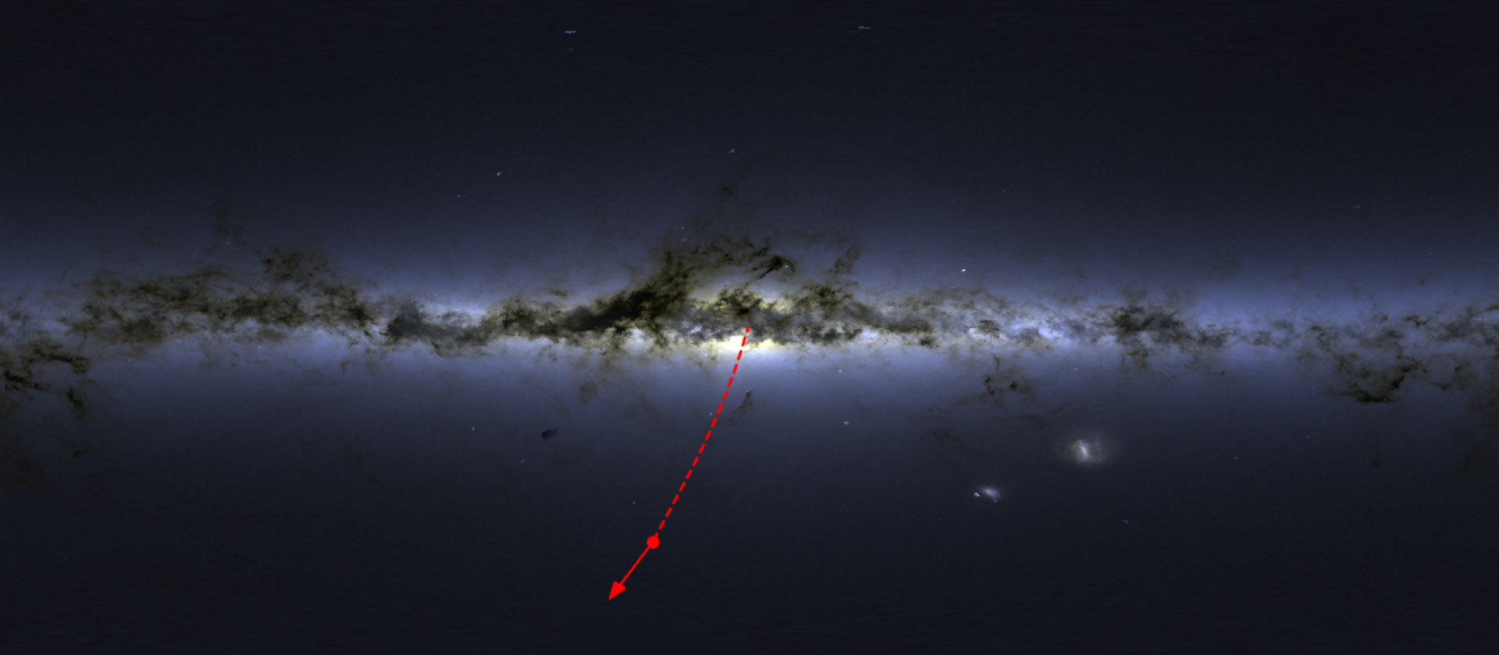
Koposov et. al.

Slide 16
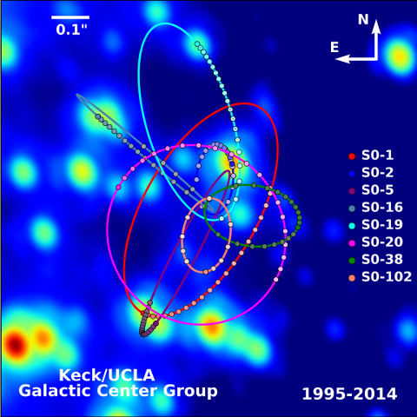
Credit: UCLA Astronomy

Slide 17
RECAP
Runaway stars are stars with velocities >30 km/s and velocity vectors pointing away from the disk.
There are multiple ways of creating main-sequence runaways:
Binary Supernova Scenario
Open Cluster Dynamical ejection
Hills Mechanism
There are differences:
Hills produces the fastest stars which point directly to the center
DES implies that the age of the star must be similar to the age of cluster
BSS produces stars with imprints of binary interaction: High Rotation, He

Slide 18
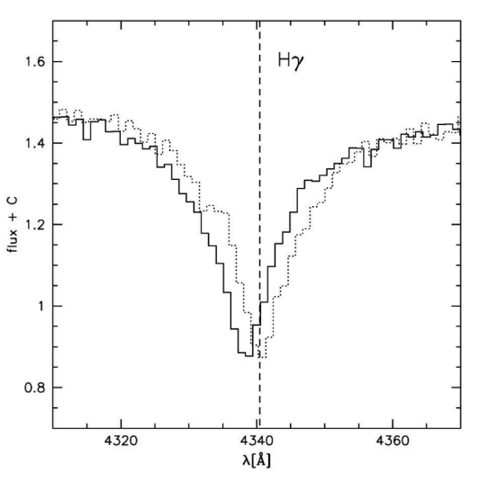
6-d Kinematics
4d + α,δ
Jason Kendall on Youtube
$v_{R}=\frac{Δλ}{λ}c$
d=1/parallax
Proper motion measured by change in angular position

Slide 19
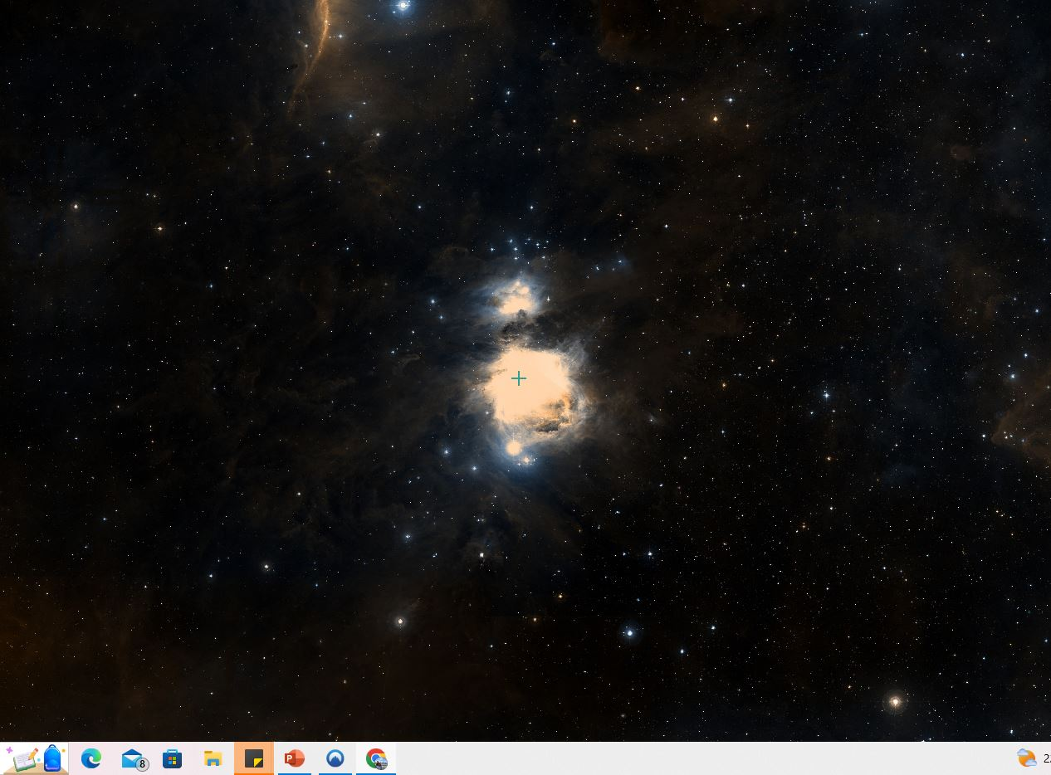
How to study them?
We can use runaways in two ways
Study a cluster and find runaways from it

Slide 20
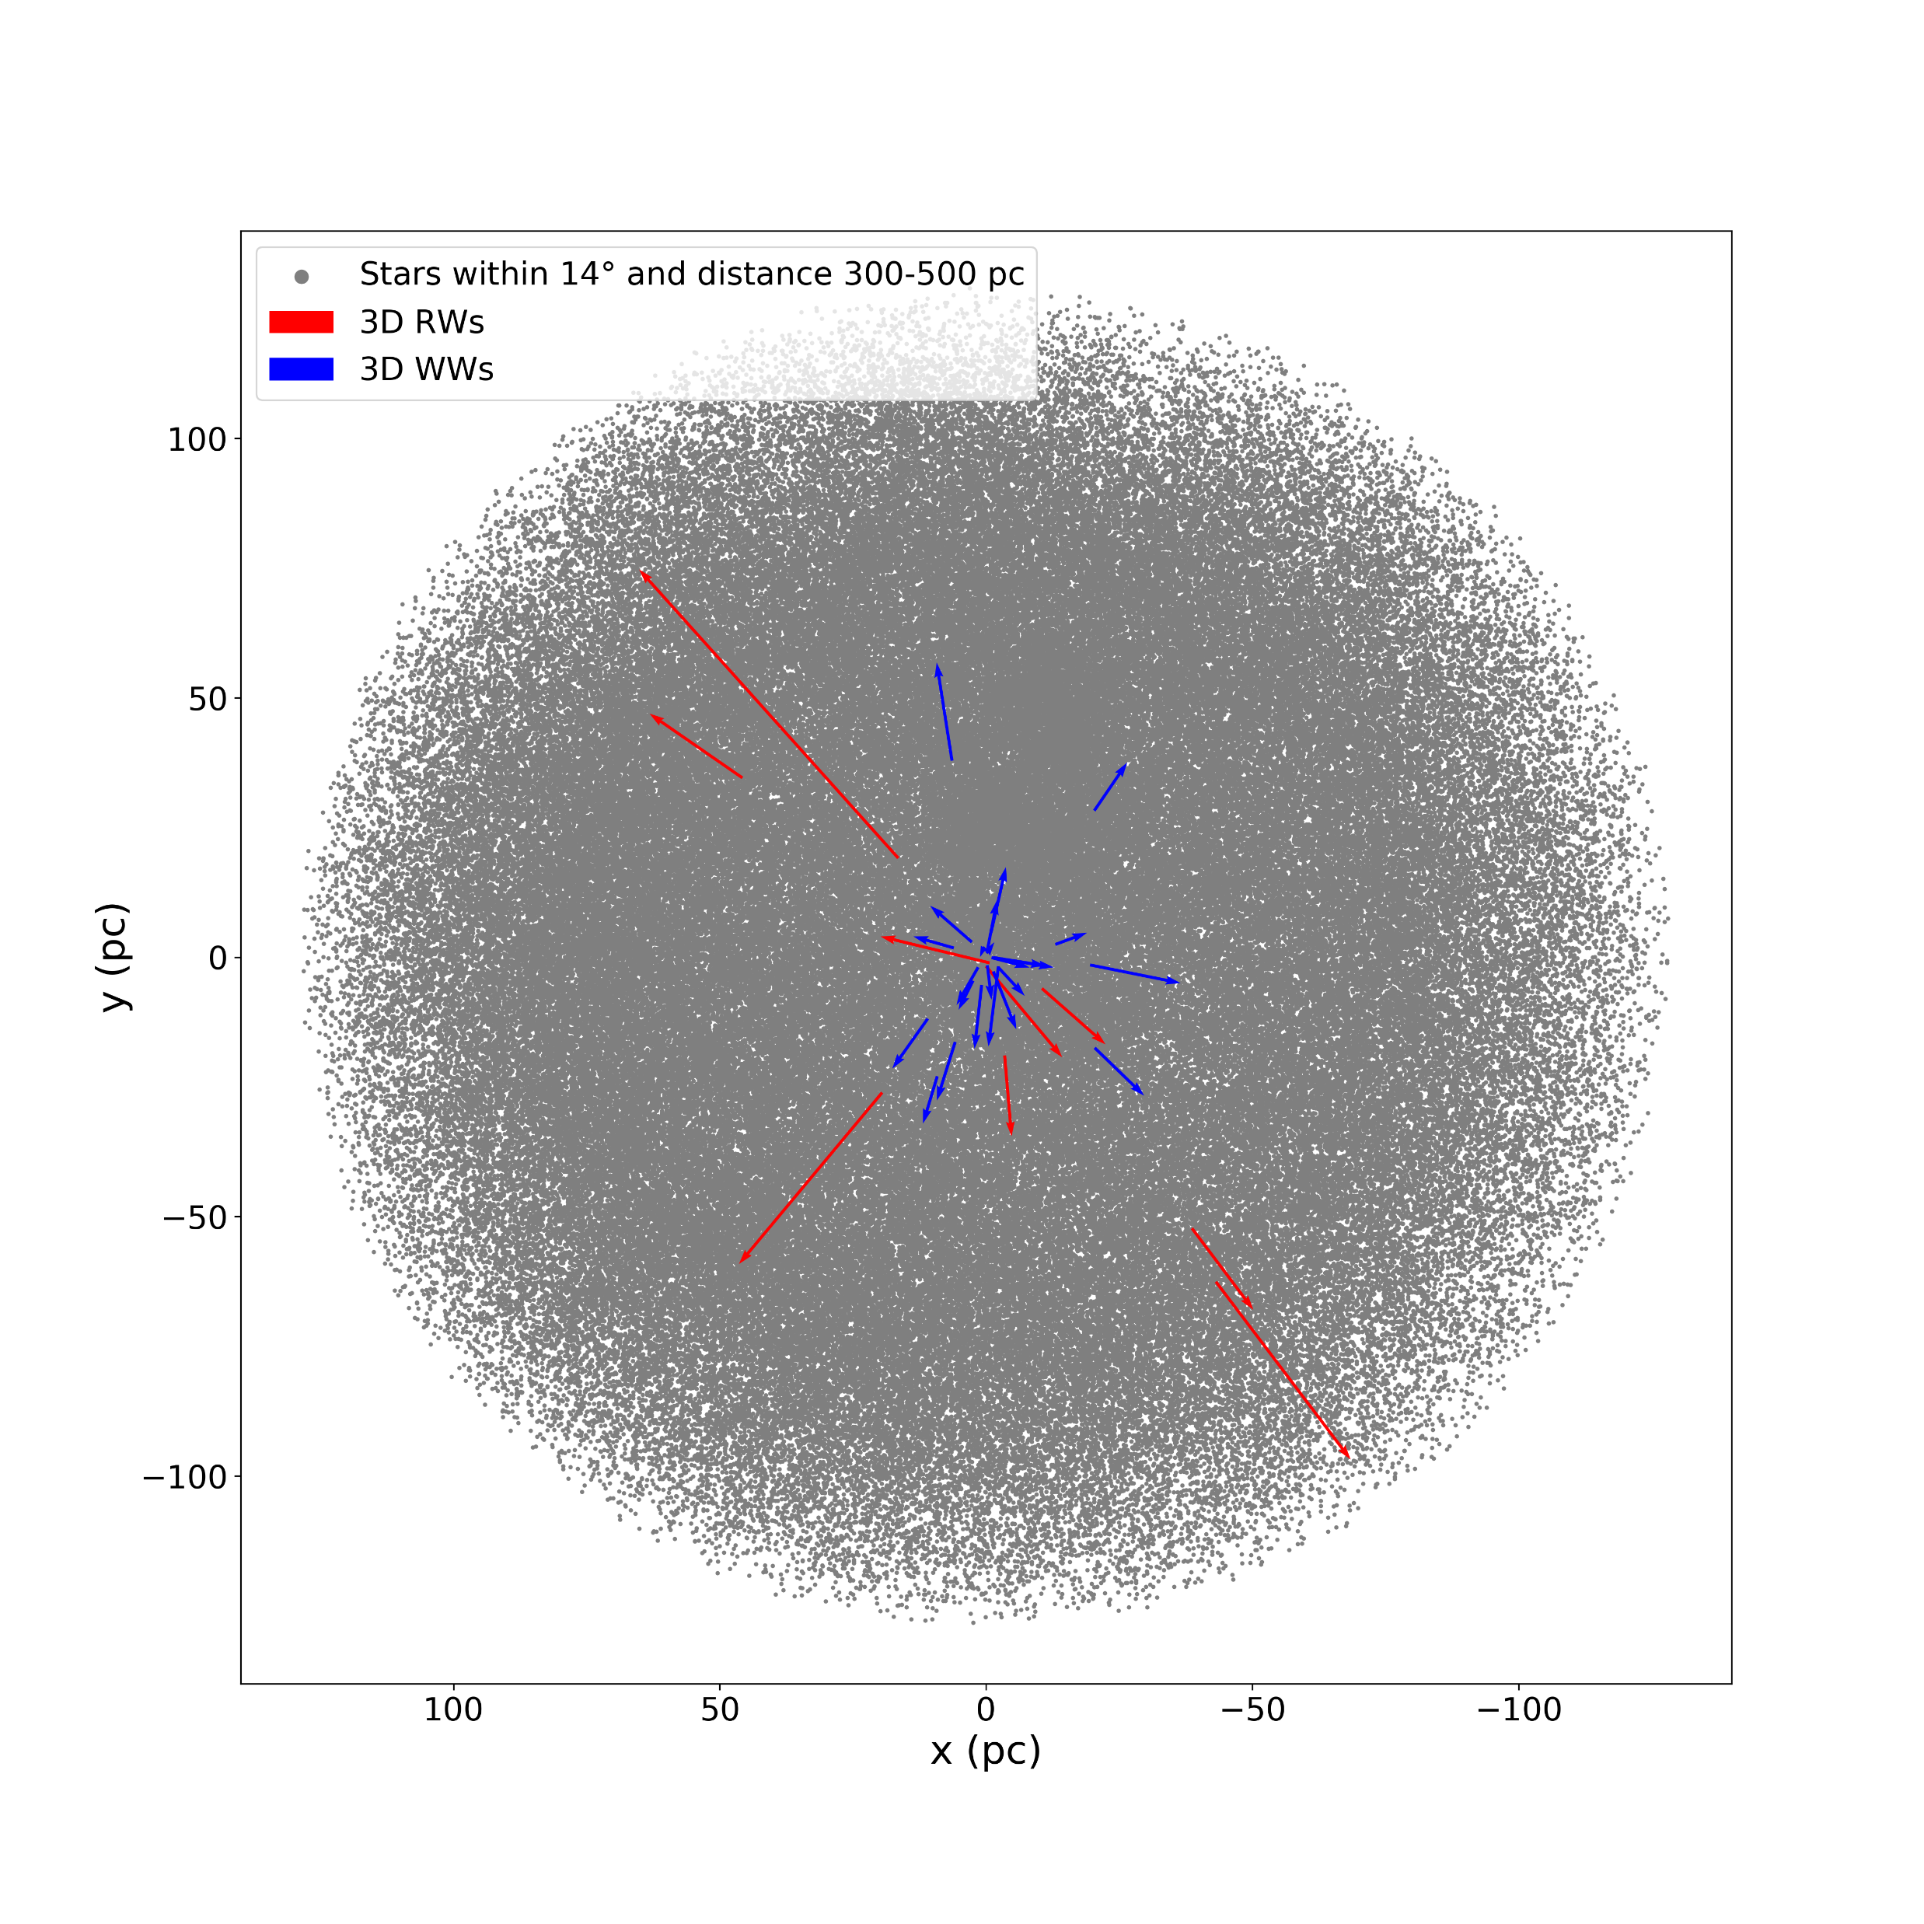
Orion by Farias and Schöttler

Slide 21
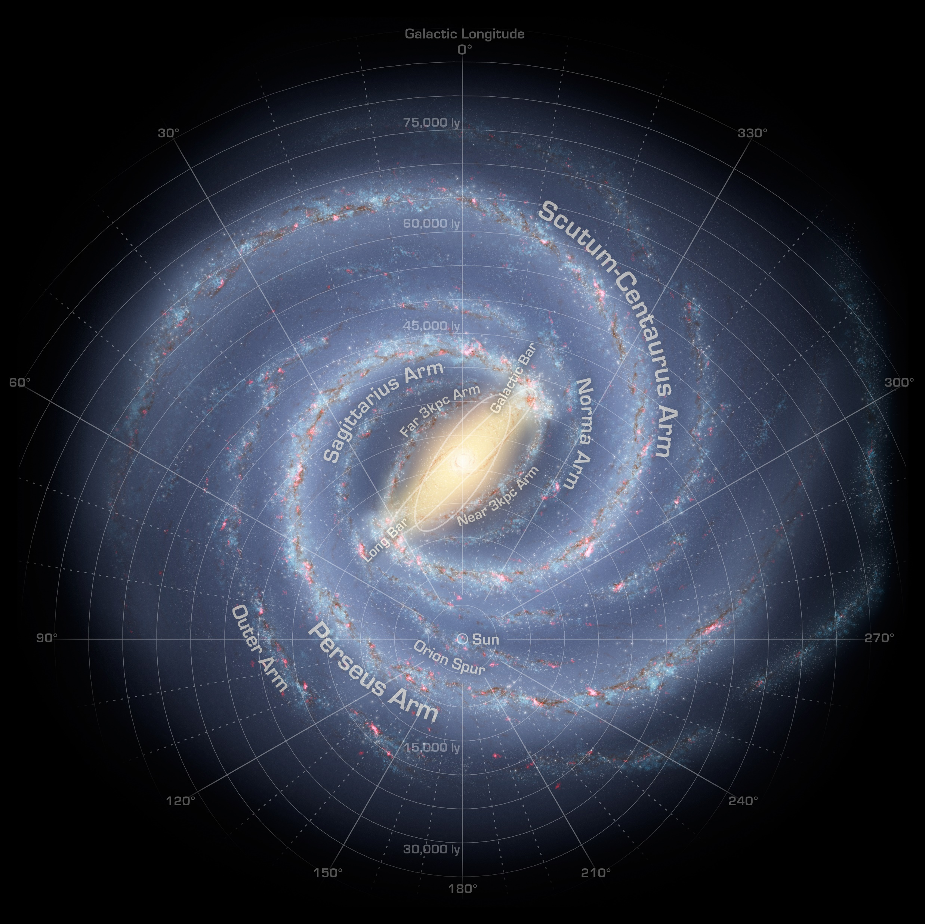
Method 2: Study Runaways and find their clusters

Slide 22
Halo: Sphere
Bulge
Disk

Slide 23
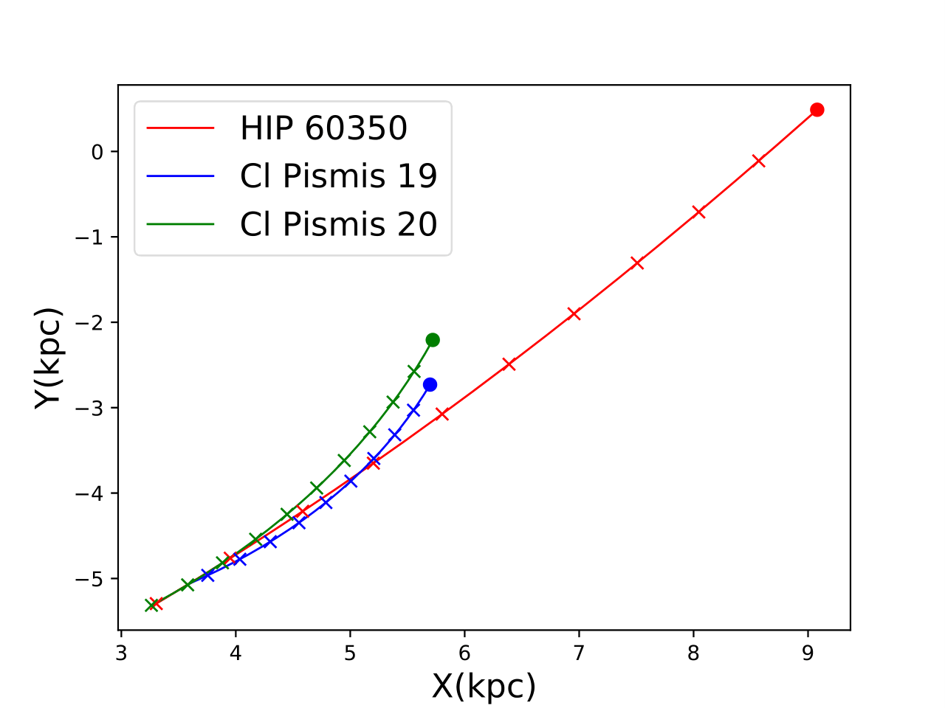
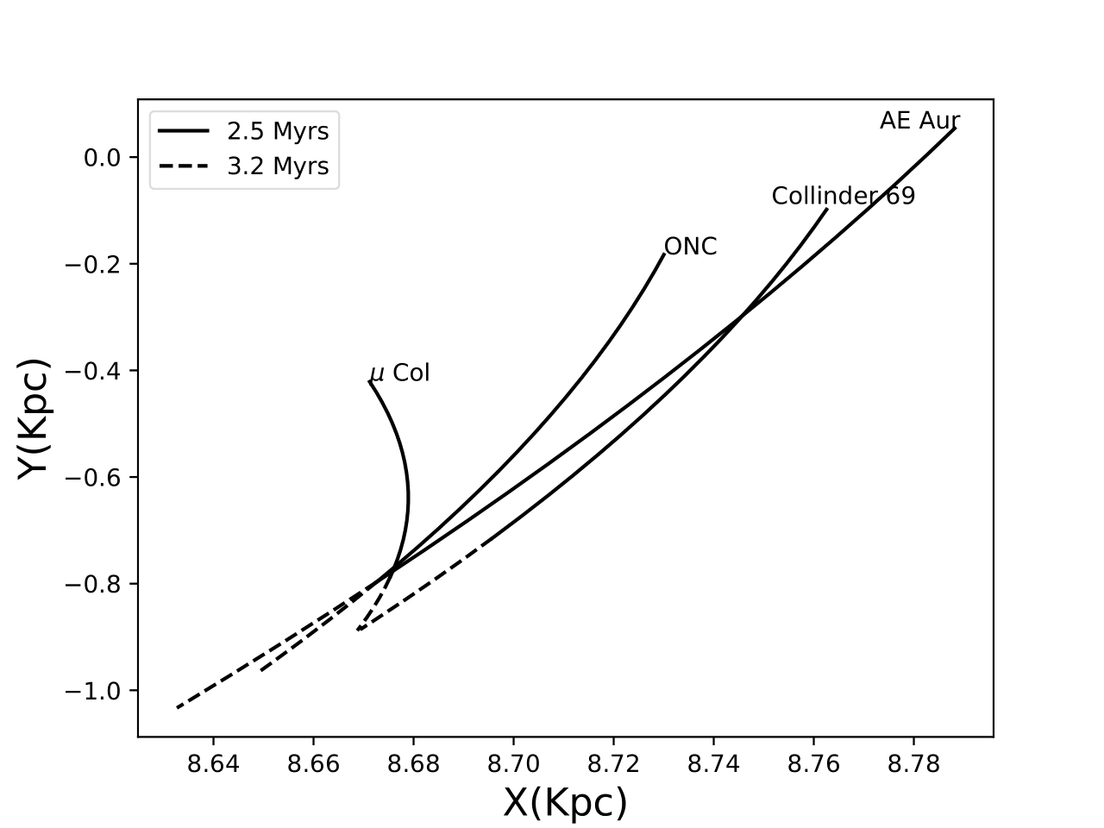
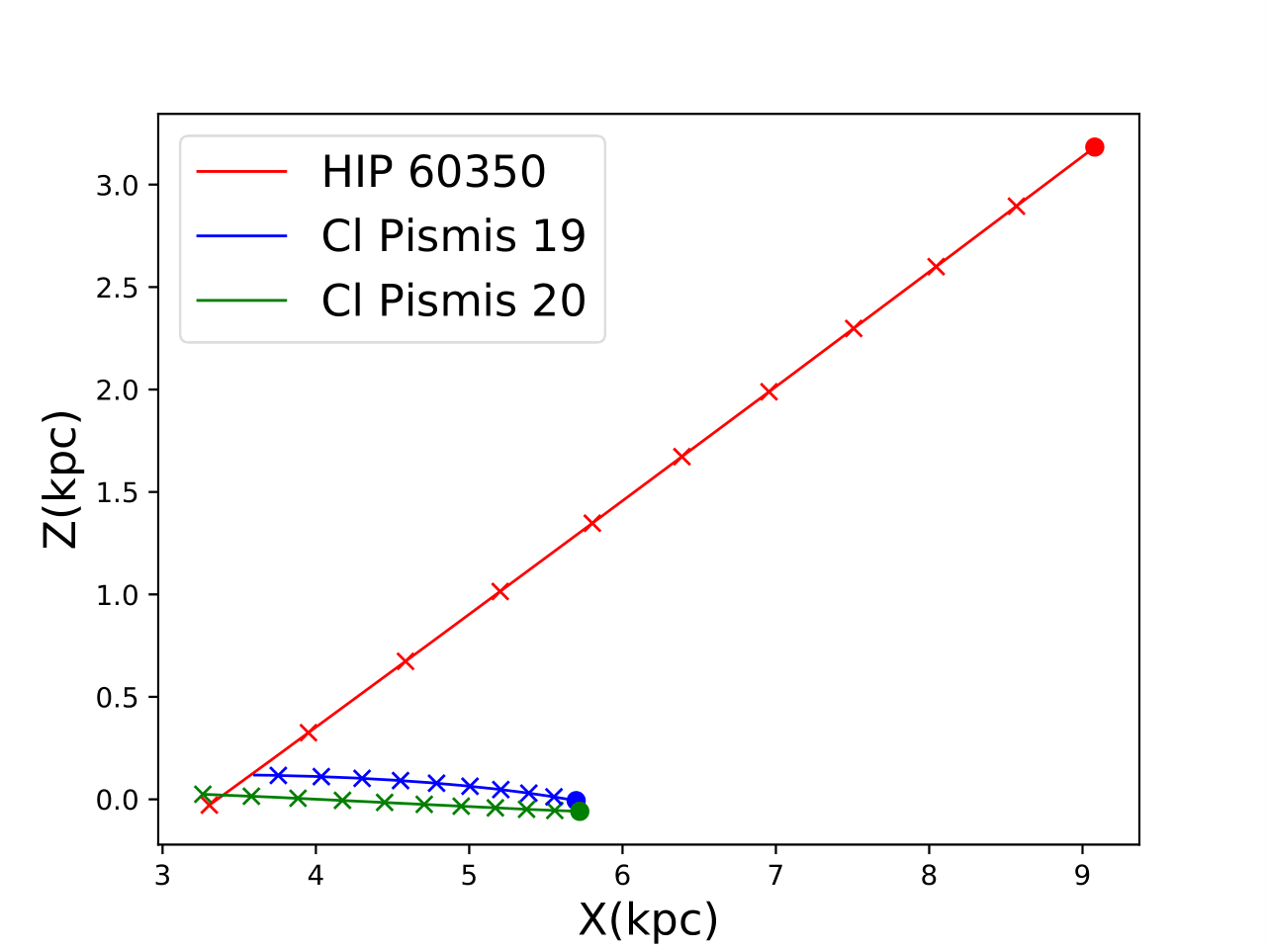

Slide 24
What is different about this project?
So far, we have studied well known stars and collected kinematics based on literature values. These tend to be bright, nearby, high declination objects.
But if we want to find the missing runaways, we need to start from scratch: Find our own targets, take our own measurements, do our own spectral analysis.
And if we are lucky, we might find something new!

Slide 25
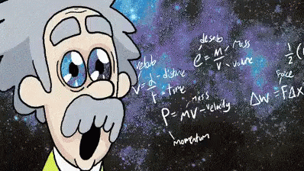
What can we learn?
Stellar Evolution (Life, Death, Afterlife)
Cluster formation
Galactic structure (Mass Function)
Supernova rates and star formation
If lucky, common enevlope/accretion

Slide 26
How to find the Target without RV?? Use other 5 kinematic values
The catalog we use to select stars from is the catalog of Reed from 2005
In vizier: V/125/obcat
https://ui.adsabs.harvard.edu/abs/2005yCat.5125....0R/abstract
Mag<11

Slide 27
We can use Gaia and Simbad (5 arcsec each) to get:
Tangential Velocity: 4.74*pm/parallax>25 km/s
Galactic Z coordinate: >150 parsec (0.15 kpc) (icrstoGal(polarXYZ(ra,dec,1/parallax)))
RUWE <4 (Is our Parallax reliable? Especially bad if stars are binaries)
Parallax>0 and parallax_over_error>4
!(abs(radvel)>=0) in Simbad
To prioritize make your list decreasing order by gal_z and by main_type=„star“

