Slide 1
SUNDIAL - Combining Astronomy and Computer Science to Understand the Formation and Evolution of Galaxies
Johan Knapen, IAC 30 June 2017

Slide 2
What is SUNDIAL?
SUNDIAL is an EU-funded Innovative Training Network, running from 1 April 2017 for 4 years (budget 3.7 million EUR, PI Reynier Peletier from Groningen, NL)
Follow-up from the succesful ITN DAGAL (Coordinated by IAC, PI Knapen)
The SUNDIAL project is a fully interdisciplinary collaboration between astronomers and computer scientists
Team includes Astronomy and Computer Science Partners:
Groningen, Netherlands (A, CS)
Gent, Belgium (A)
Heidelberg ARI, Germany (A)
Napoli, Italy (Obs + Uni, A, CS)
Oulu, Finland (A)
IAC Tenerife, Spain (A)
PARIS ESIEE, France (CS)
Birmingham, UK (CS)

Slide 3
What will SUNDIAL do?
Provide vital tools for automated analysis of large upcoming datasets such as those of EUCLID and LSST, by testing them on current medium-sized datasets (e.g., Stripe82, Subaru HSC-SPP, VST Fornax Deep Survey)
Educate a cohort of 14 PhD students and provide them with the skills they need to survive in the world of large datasets of the future
PhD students will all start around September 2017
Organise meetings, training schools
Publish training materials
Outreach (includes talks, press releases, teaching material for kids and for advanced students (MOOCs), Galaxy Zoo link, etc)

Slide 4
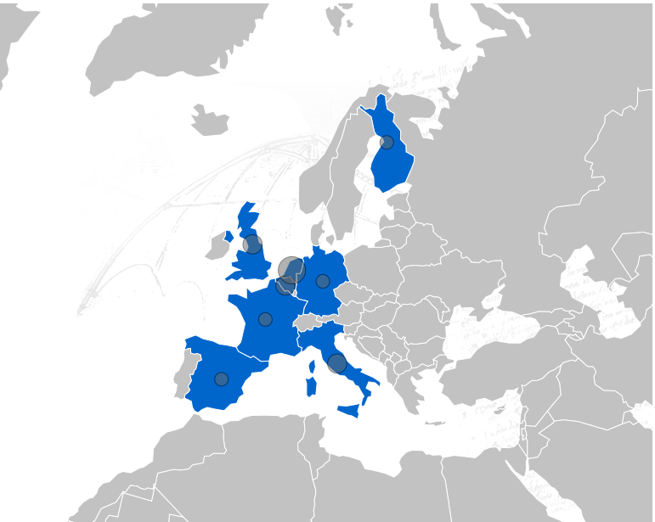
SUNDIAL Partners
Gent (A)
Oulu (A)
Birmingham (CS)
Groningen (A+CS)
Heidelberg (A)
ESIEE (CS)
Naples (Obs. + UNIV (A+ A/CS))
IAC (A)

Slide 5
SUNDIAL Industrial Partners:
IBM (Zürich) Cloud and Computing Infrastructure, and Cognitive Computing and Computational Sciences.
TARGET Holding (Groningen) Big Data systems for Business Applications
ADCIS (Caen) Imaging applications
VICOMTECH (San Sebastian) computer vision, computer graphics and interaction
CLEVER-FRANKE (Utrecht) Data visualization, design and development

Slide 6
Solving Problems with Galaxy Formation Models:
- Missing satellites problem: the number of dwarf galaxies that we observe
is orders of magnitudes smaller than what is expected from simulations
- Dark matter: Many dwarf galaxies are fully dark matter dominated
- Downsizing: More massive galaxies are older. This is contrary to the
predictions of hierarchical galaxy formation models
- Angular Momentum: amount of rotation in dwarf ellipticals much lower than
needed for them to be supported by rotation.
- Merger history: What is the merger history of galaxies?
- Environment: What is the role of the environment in shaping galaxies?
- Dwarf galaxies: What is the origin of dwarf elliptical galaxies? Are they dead star formation dwarfs, or do they form very early-on in the Universe?

Slide 7
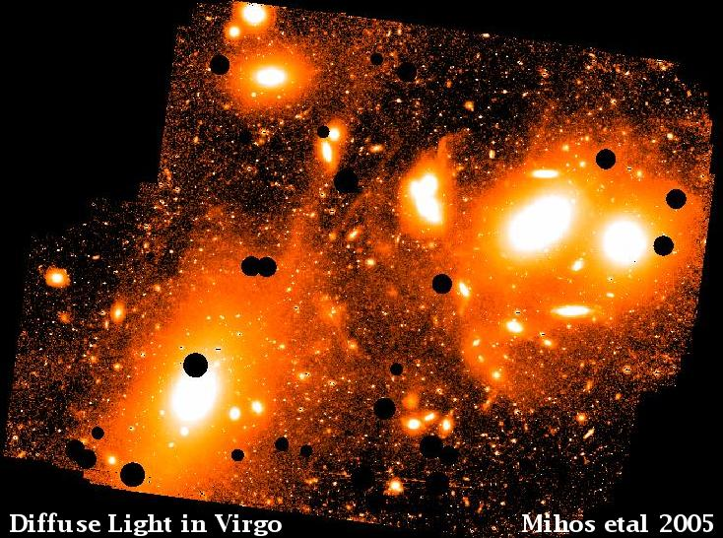
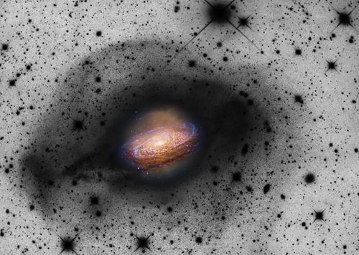
NGC 3521: Martinez-Delgado et al. 2010 – 0.5m telescope

Slide 8
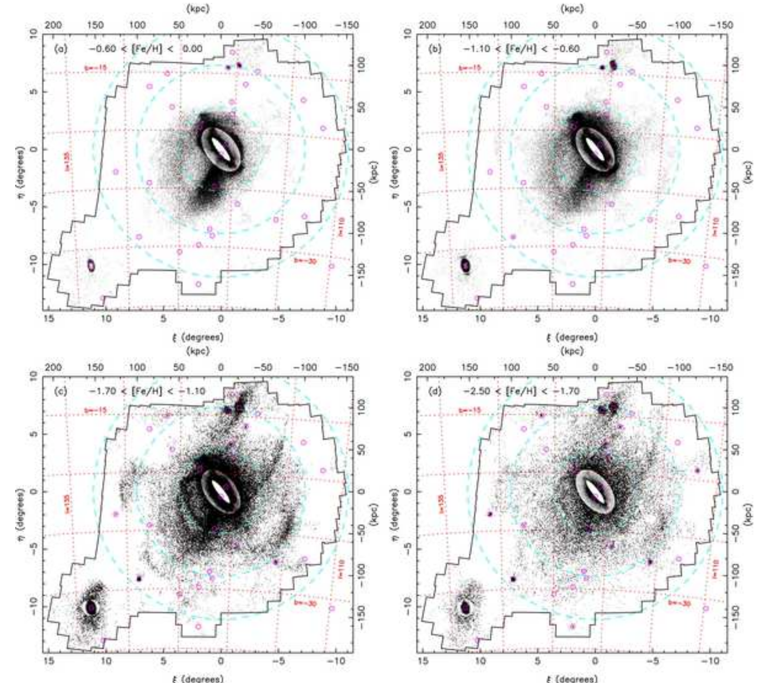
Streams and other faint features are everywhere! M31
PANDAS, Richardson et al. 2011, McConnachie et al. 2011, Ferguson 2016

Slide 9
Euclid and LSST
Will produce unprecedentedly large and deep data sets
Extremely deep all-sky (or very large part of it) imaging
For instance LSST: 20 gigapixel camera read out every 30 s, 20Tb of data per night, one exposure as deep as SDSS/Stripe82
Need automated mechanisms to analyse faint galactic structure

Slide 10
Illustration of what SUNDIAL will do: Step 1: deep astronomical imaging
Need proper treatment of systematics, including:
Flat-fielding
Background subtraction (most deep imaging surveys are optimised for point source extraction and over-subtract)
Scattered light (in atmosphere+telescope+instrument+camera)
PSF (=point spread function) changes with time, position on sky, etc
Foreground stuff (incl. zodaical light, Galactic cirrus)

Slide 11
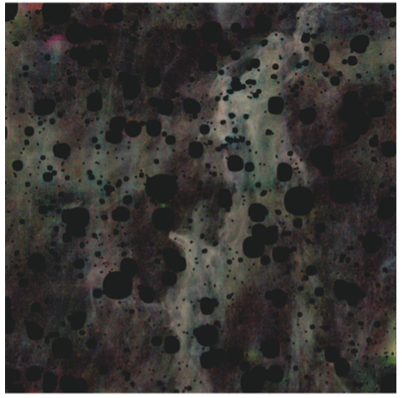
What you see when you mask out all stars and galaxies: very faint (>27 mag arcsec⁻²) Galactic cirrus in a deep Stripe82 optical image

Slide 12
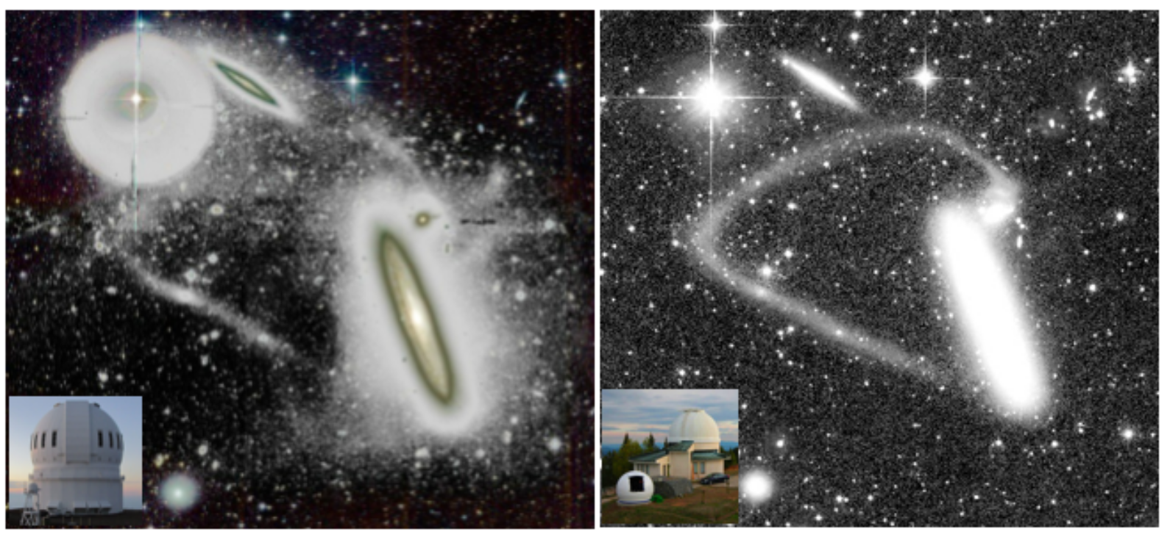
Many artifacts come from the telescope/camera
CFHT
Irida Observatory – Bulgaria
(small telescope)
(from Duc (2016))
(see also Martinez-Delgado et al. 2010)

Slide 13
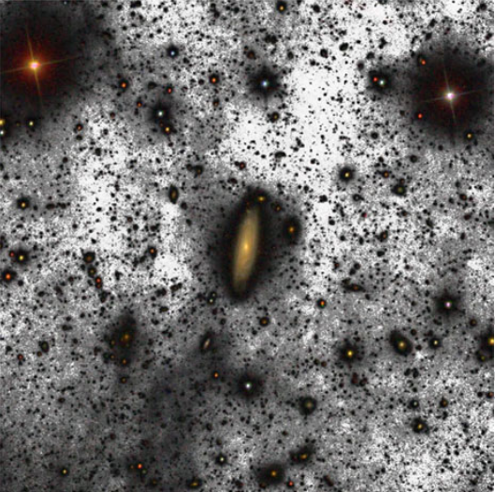
Ignacio Trujillo’s deep 10.4m-GTC image of the UGC 00180 field
Trujillo & Fliri 2016, ApJ 823, 123

Slide 14
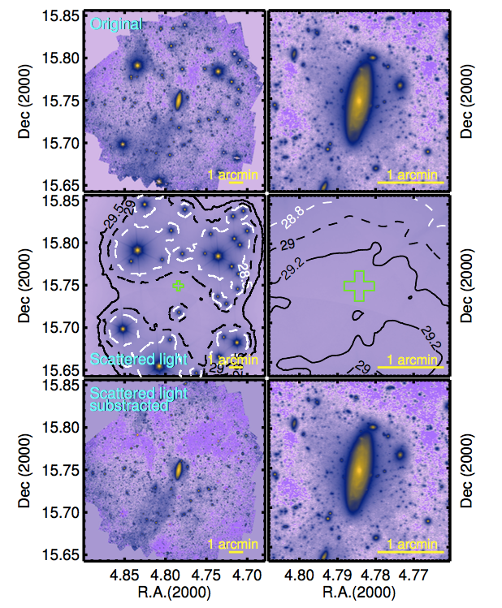
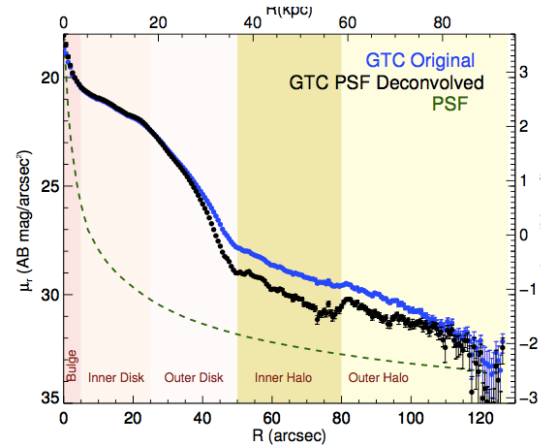
Effects of PSF correction on deep image (left) and radial surface brightness profile (top). Image of UGC 180 from Trujillo & Fliri 2016, ApJ 823, 123

Slide 15
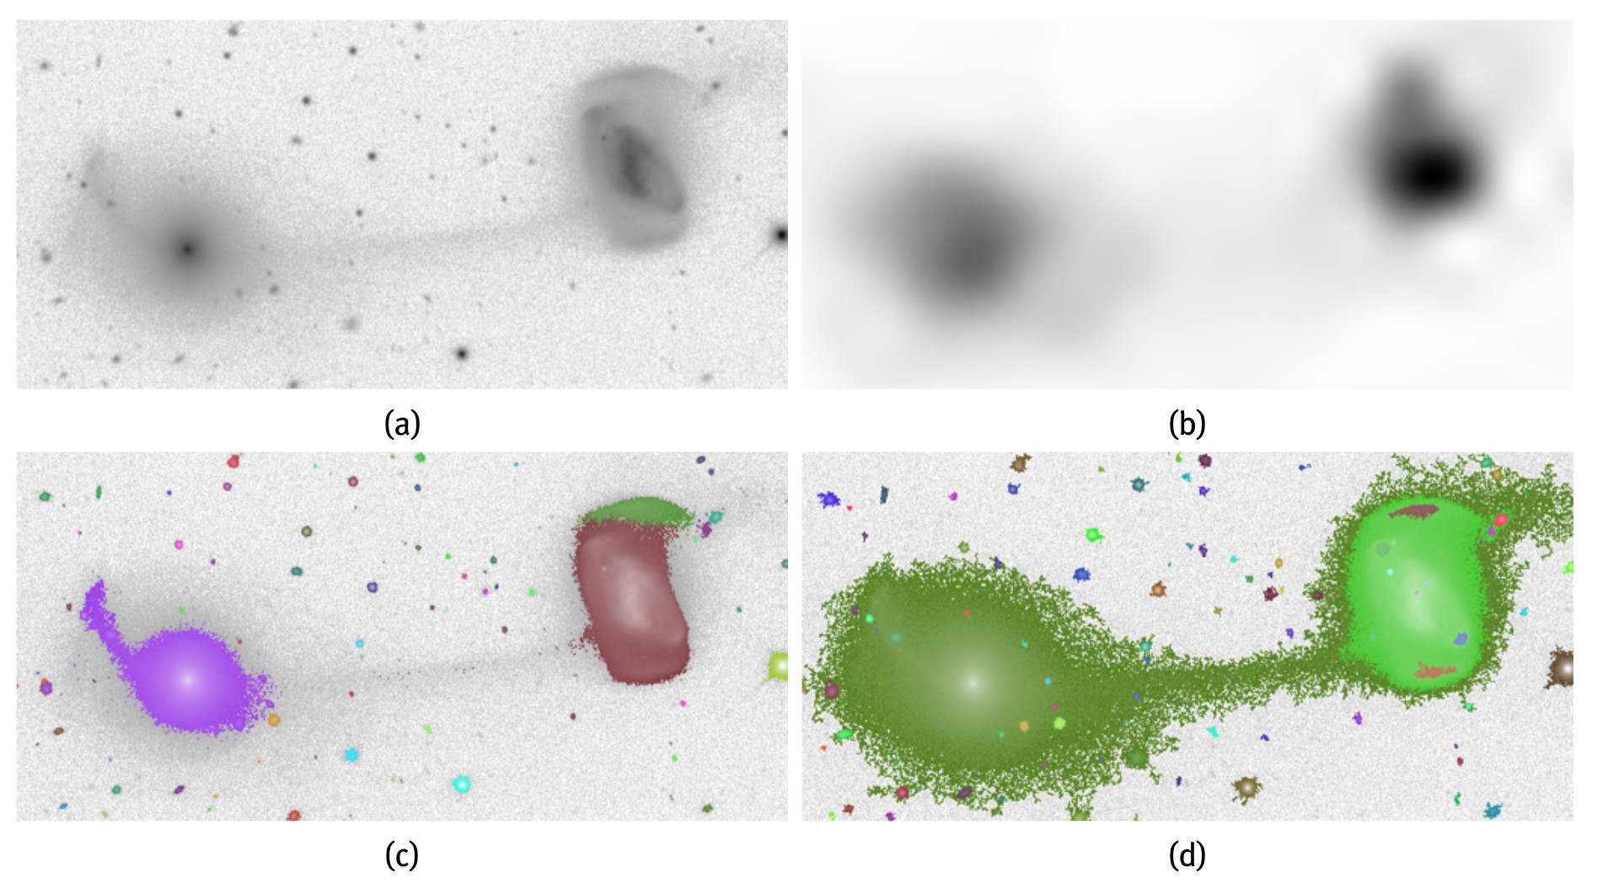
Step 2: automatic detection of ultrafaint objects
Teeninga, Moschini, Trager & Wilkinson 2016 (Math Morph Theory & Apps)
Panel (c): Sextractor. Panel (d): Max-Tree based approach
Improving results based on Sextractor, based on statistical attribute filtering

Slide 16
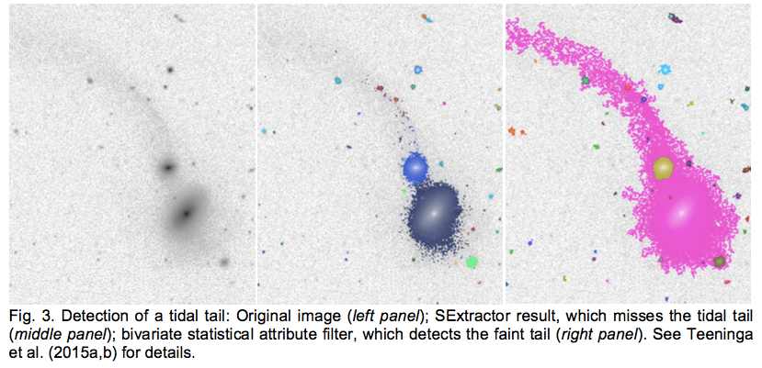

Slide 17
Aims of network:
Interdisciplinary collaboration of astronomers and computer scientists to determine novel algorithms to study galaxy evolution. In particular:
(1) Automatic detection of faint low surface brightness galaxy features (dwarf galaxies, merger remnants, intracluster light) in deep astronomical surveys, and interpreting them astrophysically in terms of galaxy formation and evolution.
(2) Automated object recognition in Big Data sets with prior information from astrophysics: (a) unsupervised identification of groups of objects with similar properties (clustering) and (b) supervised assignment of objects into pre-defined target classes (classification)
(3) Simulations of galaxy interactions, their characterisation and visualisation. Comparison of simulations and observations will lead to a better parametrisation and understanding of galaxy cluster evolution.

Slide 18
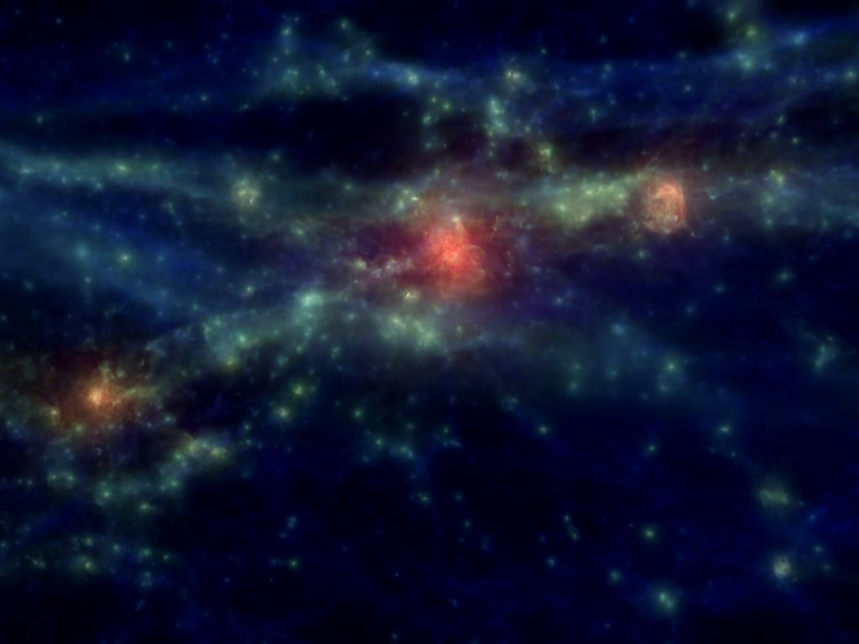
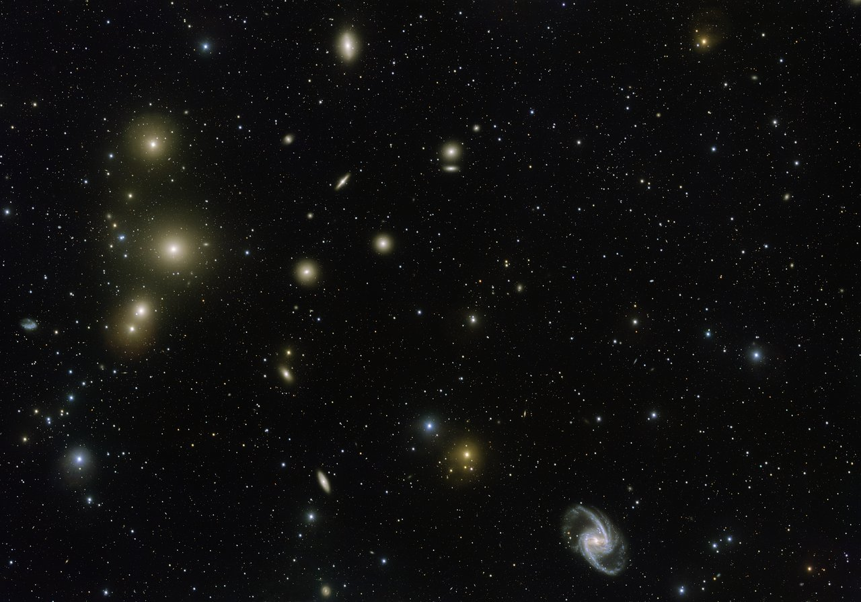
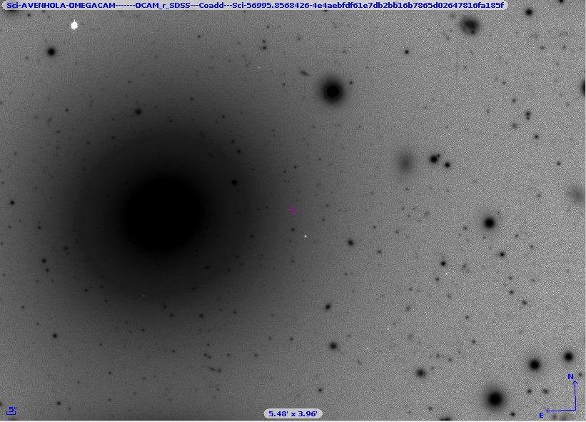
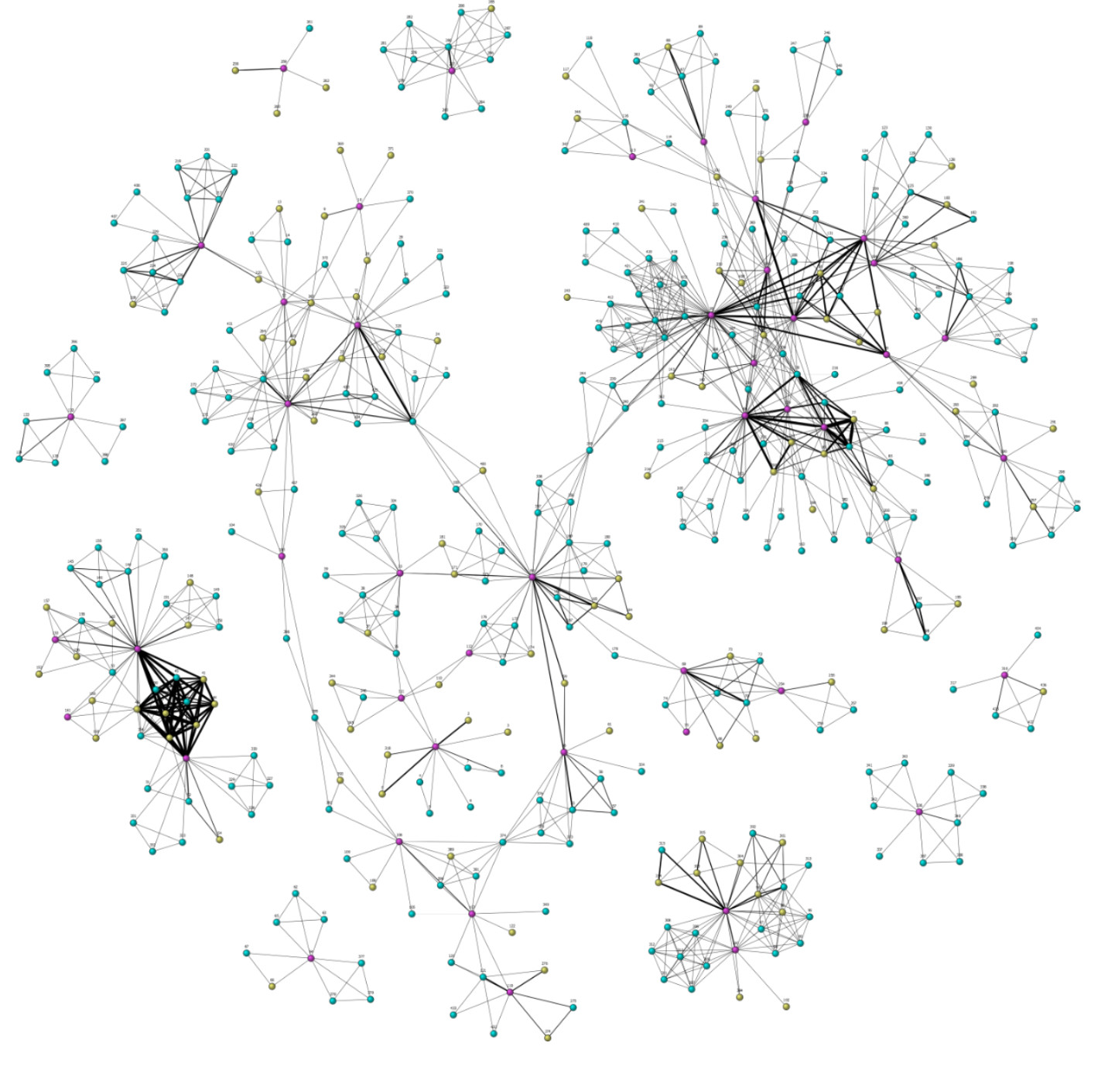
Visualization
Develop visual data analytic tools to optimally visualize simulations and observations.
Follow newest developments, in connection with companies.

Slide 19
Plus additional training and outreach activities
Many of these events will be open to non-SUNDIAL students

Slide 20
Community involvement
Personal links and collaborations
Building bridges between the SUNDIAL departments (A and CS)
Co-organising meetings (this one, EWASS 2018?)
Overlap in people: COST, LSST-Europe, etc
Follow-up proposals (H2020, COST, etc)
Attendance at SUNDIAL meetings and training events
Publication of SUNDIAL training & outreach materials
Final international conference (2020)
General: increased collaboration between Astronomy and Computer Science (in area of morphology of galaxies)

