Slide 1




Big Data in Space
Big Data in our computers
Edwin A. Valentijn
Prof Astronomical Information Technology
Target- OmegaCEN – Kapteyn
30 June 2017 EWASS Astro informatics

Slide 2
Mmodern data federations in Astronomy
Distributed Information Systems
  Users, computers, storage
Process and Quality control
Reproducable - ( re-processing)
Open Science - FAIR principles
Findable Accesable Interoperable Reproducable

Slide 3

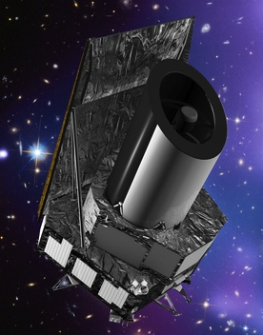

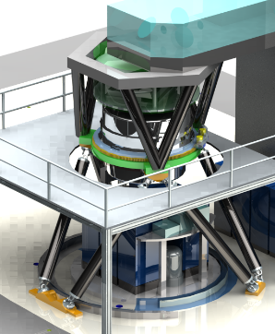
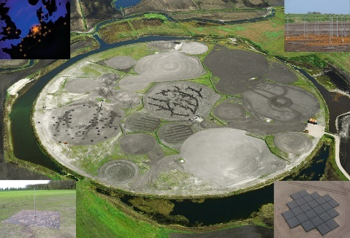
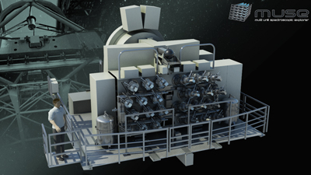
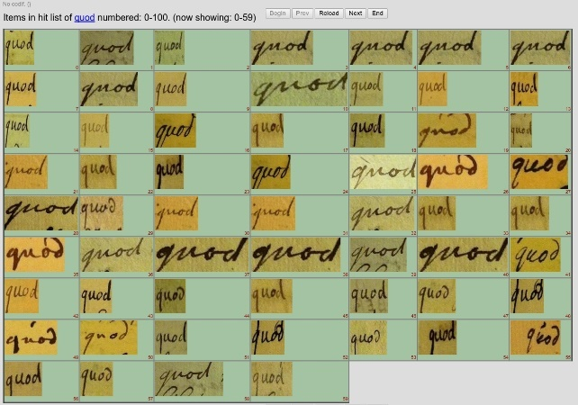
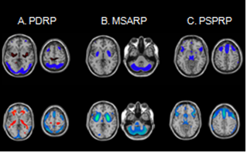
Astro-WISE – Data federations
Distributed Information Systems - handling surveys since 2003 - it works
OmegaCEN@Kapteyn datacenter ~15-20 fte
KiDS - ESO – OmegaCAM@VST
MUSE - ESO - VLT
Lofar - LTA - Astron
Glimps - AI Handwritten text – Lifelines DNA
Target Holding
-> Euclid - ESA
-> Micado - ESO - ELT

Slide 4


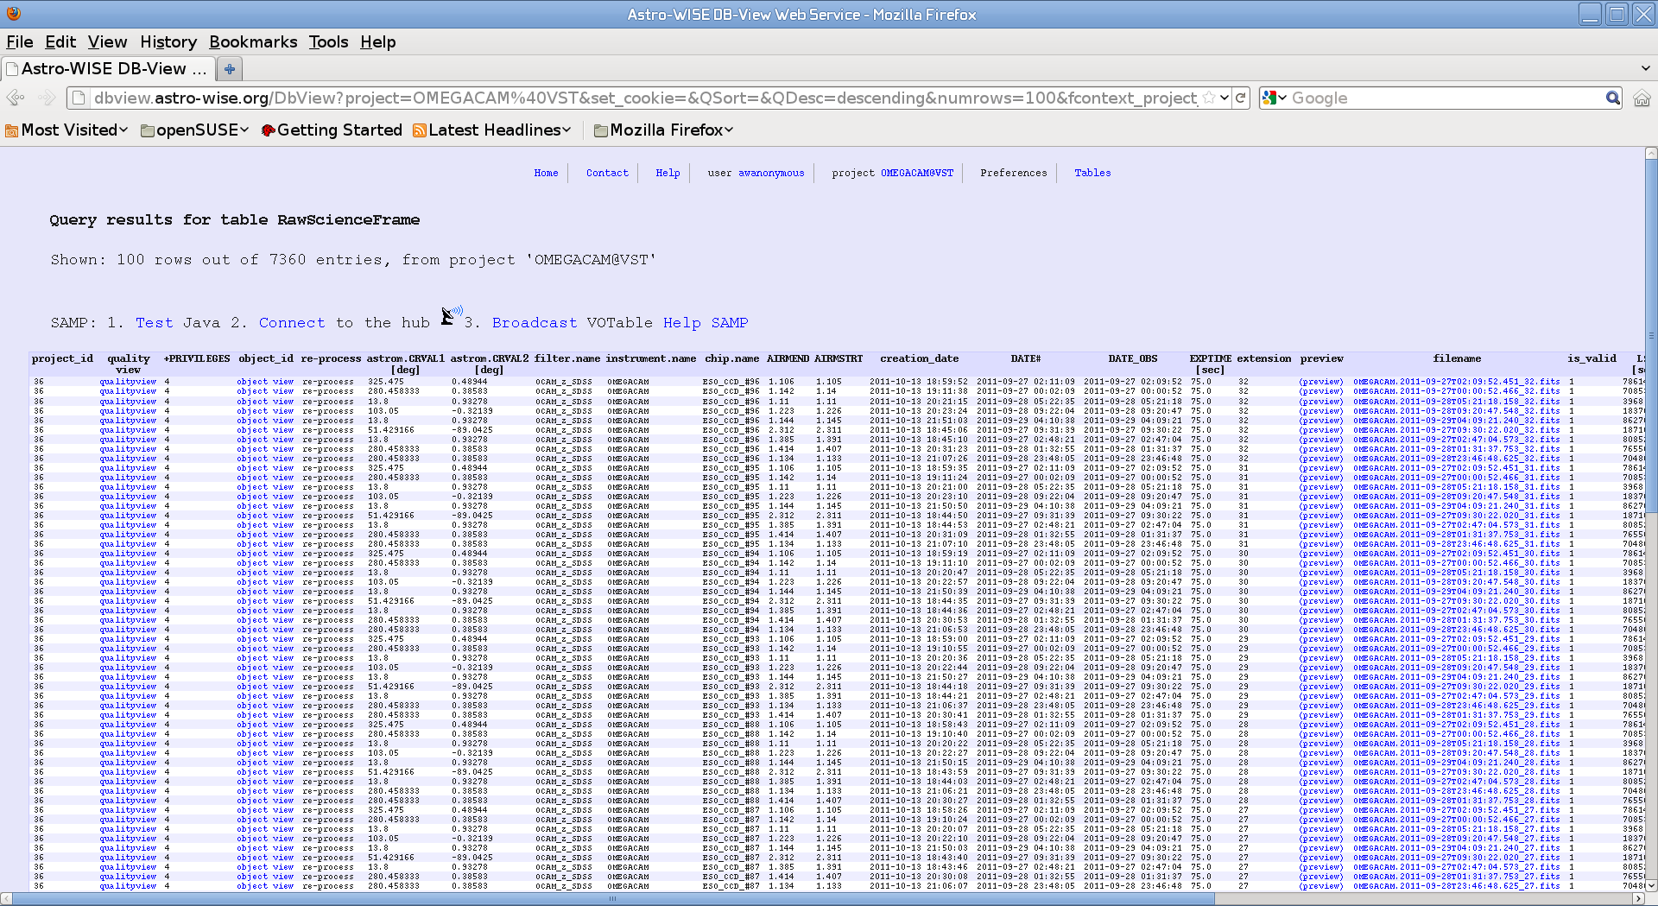
all published
http://www.astro-wise.org Manuals & tutorials
http://www.rug.nl/target Target Consortium
Experimental Astronomy - Vol. 35, 2013
All papers are online
Astroinformatics IAU symposium 325 Datafederations, Valentijn et al. 2017
Notes:
4

Slide 5
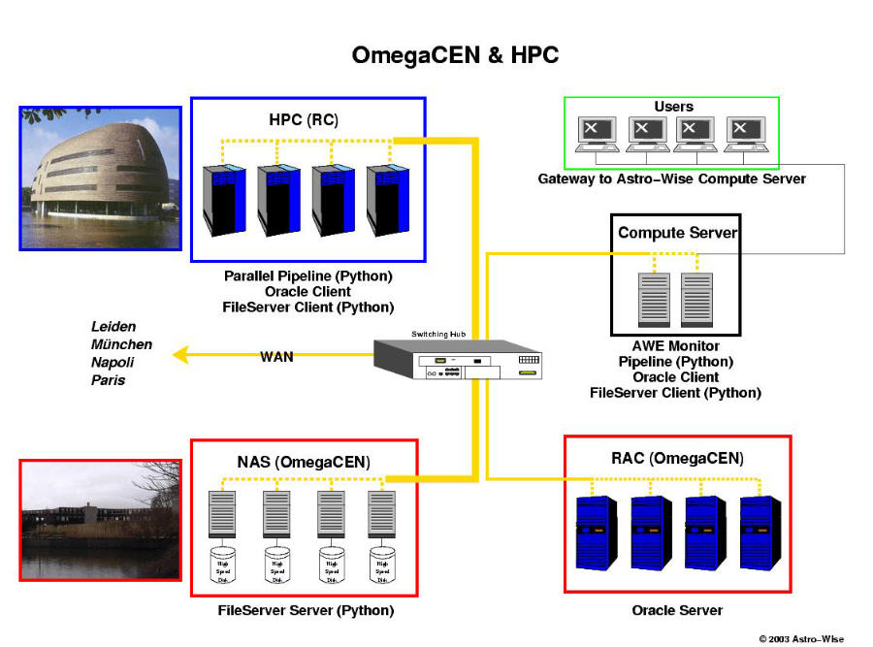
The Datacentric approach local networks and distributed
2003
RUG-CIT
1-100 Tbyte – Pbytes
DPU- Distributed Processing Unit
Distributed Data server - files
Data manage - database - metadata

Slide 6
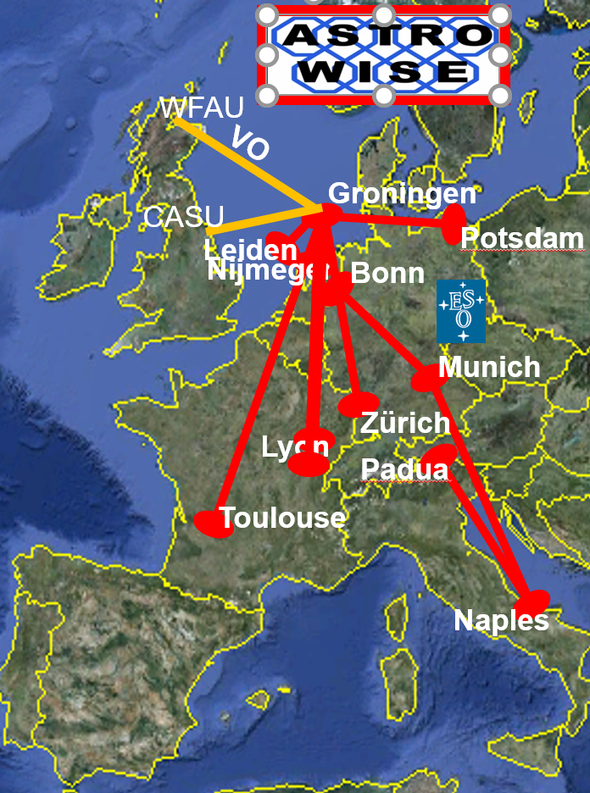
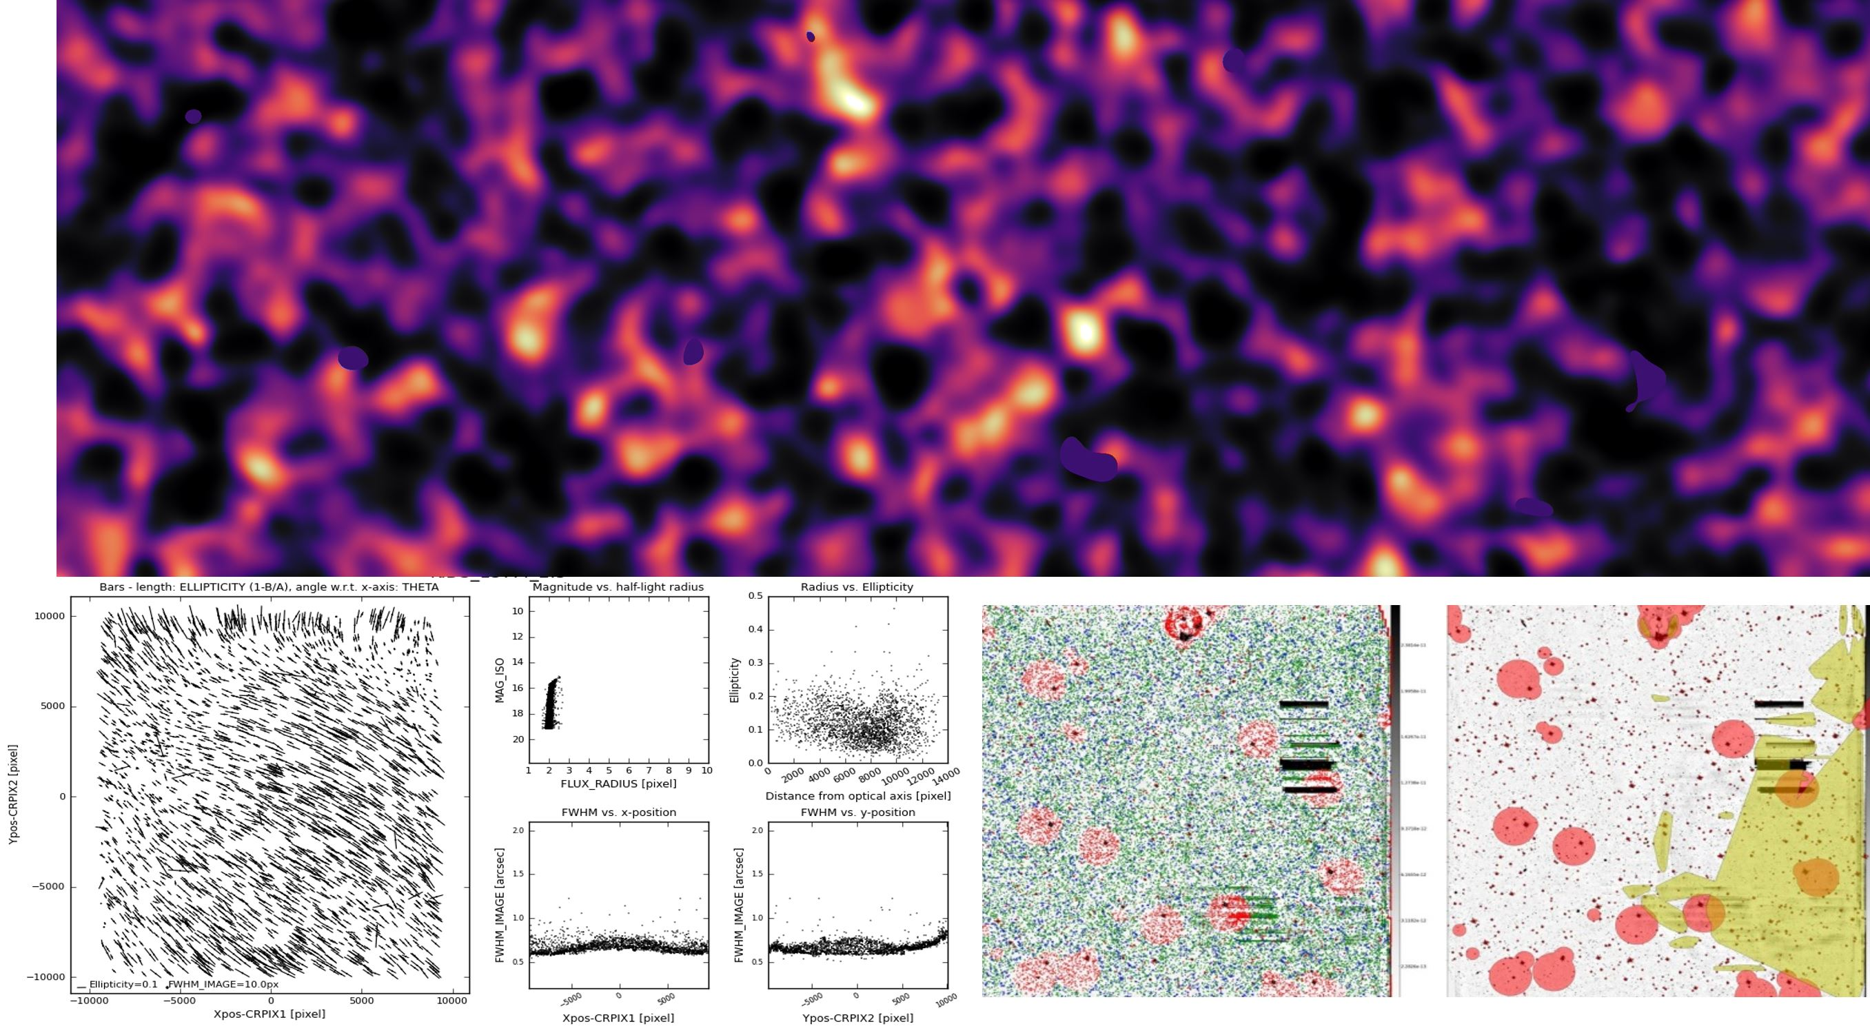
KiDS Quality control DR1-DR2-DR3
OmegaCAM@VST 740 sq deg

Slide 7
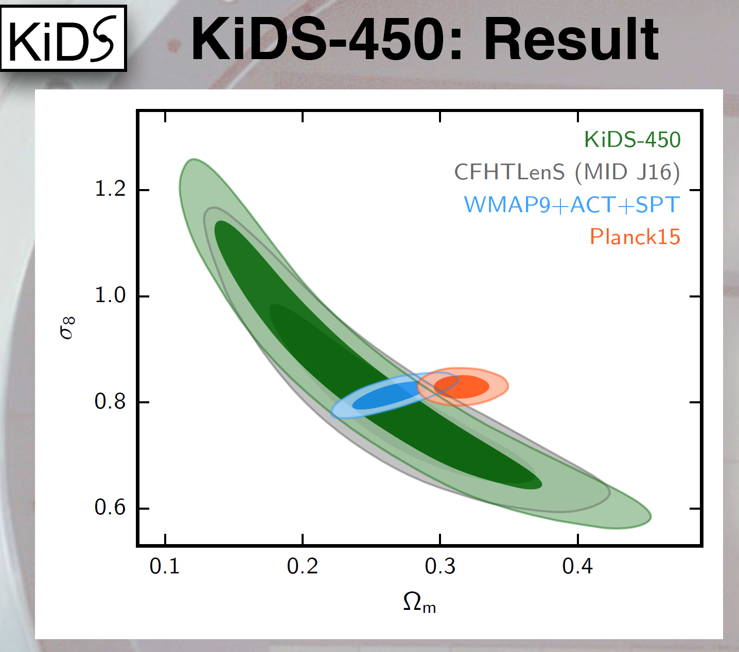

Slide 8
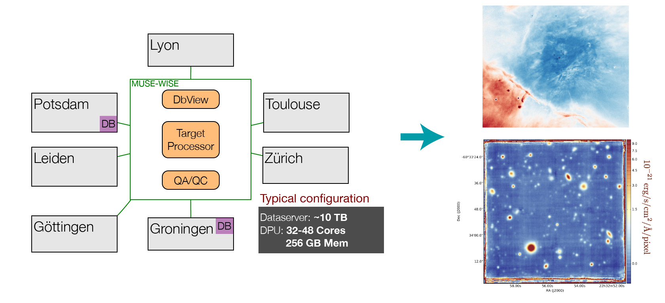
MUSE @ VLT

Slide 9
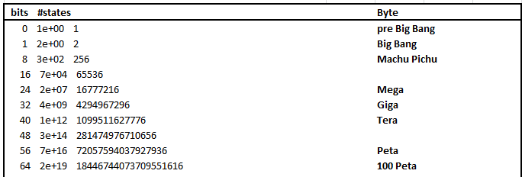
Extreme data lineage the key of Astro-WISE unified namespace – e.g. IRODS
64 bit pointer
Data about
Metadata
Big Data

Slide 10
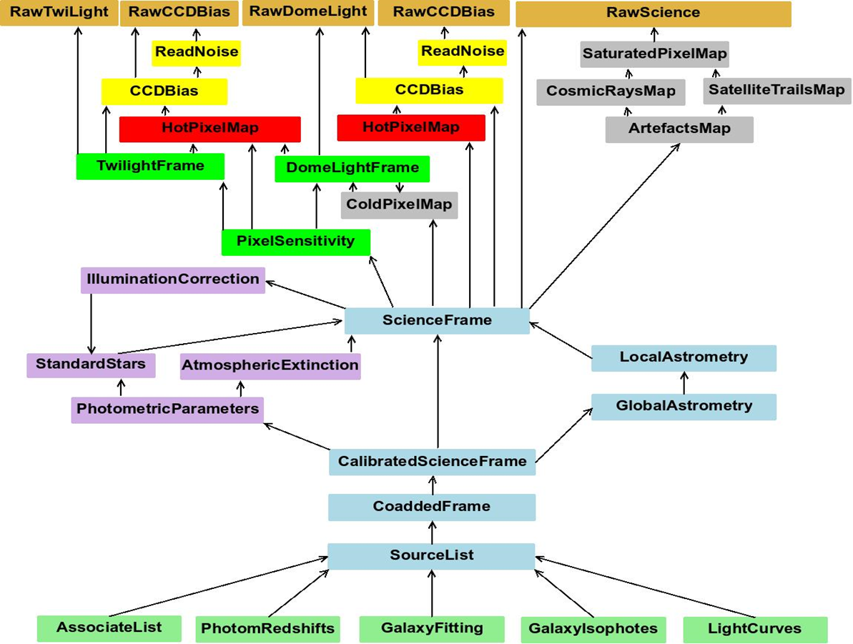
The universe as a spreadsheet
Target Diagram/Data lineage /backward chaining
++ programming - dependencies
PROCESSING
QUERY / INFORMATION

Slide 11
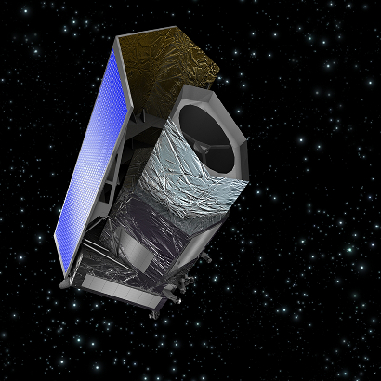
Euclid
ESA launch in May 2021
Euclid Archive System (EAS)
data centric information system
many of the WISE concepts
prototype uses Astro-WISE
hosted in the Euclid SDC-NL in Groningen
Image courtesy of ESA

Slide 12
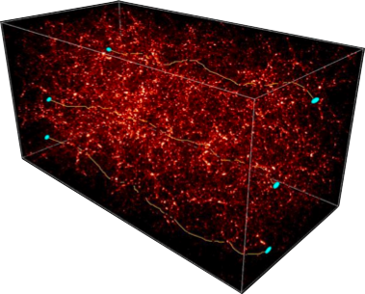
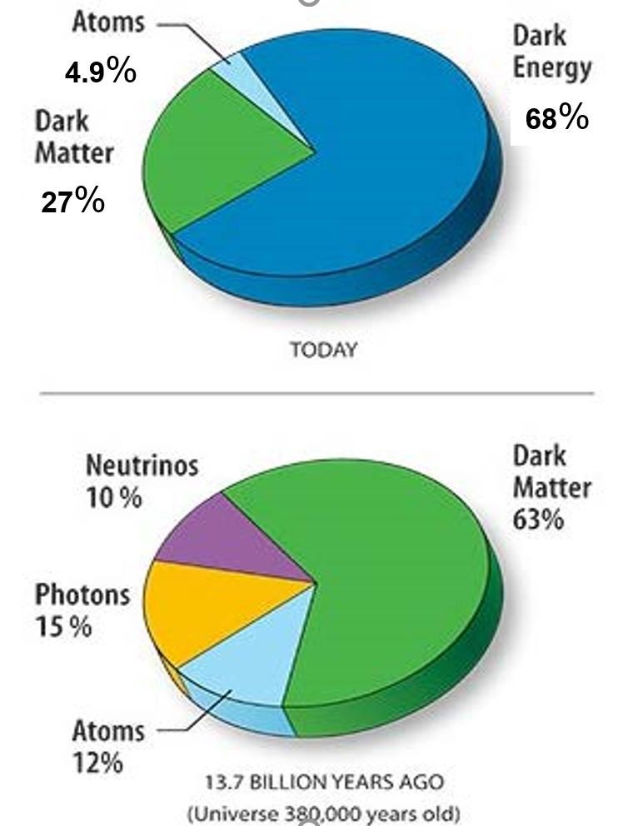
Weak gravitational lensing as probe of dark matter
KiDS: < 100 10⁶ redshifts
EUCLID: 1.5 10⁹ redshifts
Every galaxy has its own 4 PSFs
QC- bias – re-processing

Slide 13
Distributed communities acces-proces-calibrate-analyse publish
Euclid:
  1500 registered members and growing
  200 laboratories/departments
  16 countries contributing
  NASA/US: provides the IR detectors.

Slide 14
EAS Design
Integral part of SGS
Euclid Common Data Model
Consortium Services
Data Processing System
(EAS-DPS)
Science Archive System
(EAS-SAS)
Part of ESA archives
Science Exploration Data Model
Scientific Exploitation Services
Distributed Storage System
(EAS-DSS)
Computing
facilities
SOC
Computing
facilities
SDC-FR
Computing
facilities
SDC-ES
Data files
storage
Data files
storage
Data files
storage
Computing
facilities
SDC-NL
Computing
facilities
SDC-DE
Computing
facilities
SDC-UK
Data files
storage
Data files
storage
Data files
storage
Computing
facilities
SDC-IT
Computing
facilities
SDC-FR
Computing
facilities
SDC-FI
Data files
storage
Data files
storage
Data files
storage
Distributed storage system - storage nodes in each SDC and SOC
File storage with additional interfaces for Euclid services (cut-out, visualization)

Slide 15
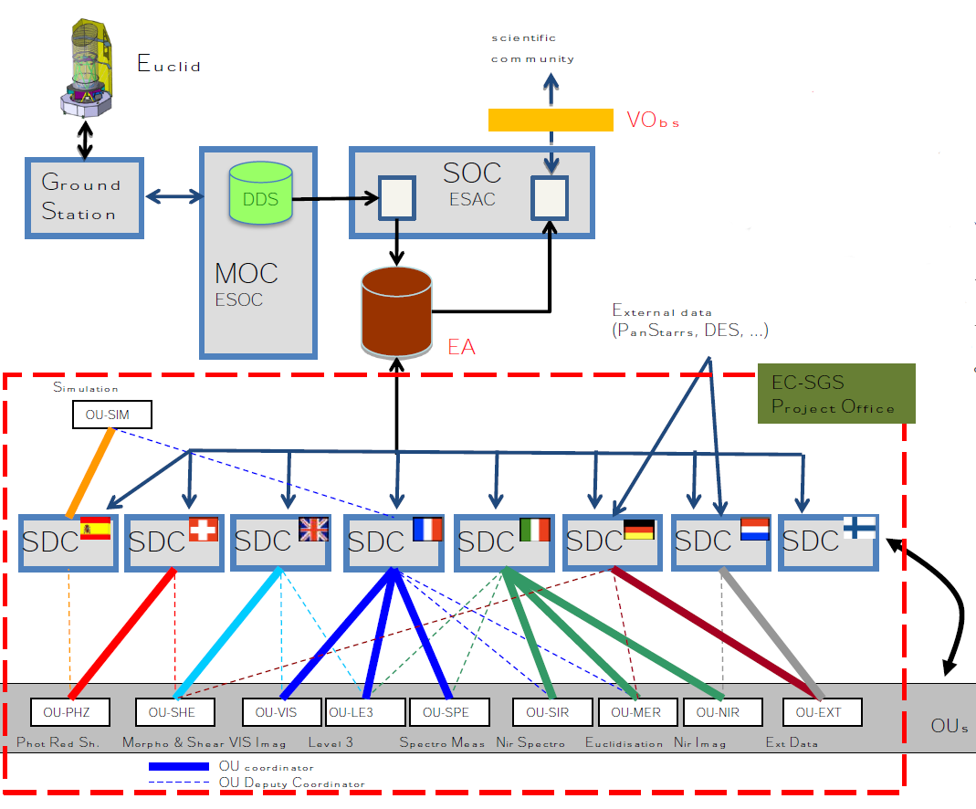

Slide 16
Data Processing System
Metadata
storage
Science Archive
System
Euclid data model in XSD
Metadata
Access Layer
Euclid Data Model
Metadata
storage
COORS
Consortium
Processing
Service
Metadata
Ingest
Service
Consortium
User
Service
EC user
EC user
public user
IAL
DSS
server
DSS
server
DSS
server
SDC-X
DSS
Storage
Node Interface
HPC
Storage node
Storage node
Storage node
SDC-Y
SDC-Z

Slide 17
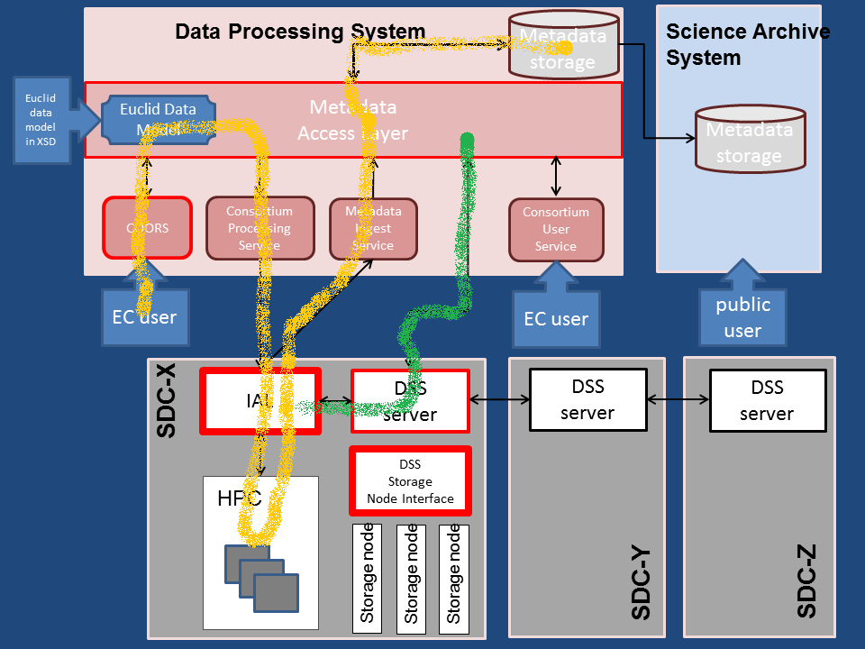

Slide 18
EnEntangled information systems
Actually we build entangled information systems
  like excel- but many levels deeper
  but now connecting photons sent billion years ago, detected on a ccd and images on one or the other display.
Note the definition of entanglement:
changing something on one end will change the result of a measurement at the other end.
It is inspiring that such notions appear to be very useful in building information systems for Big data.
The question arises
  Is this something fundamental?
  Is information fundamental?
  What is the role of information in physics?

Slide 19


Information both in Physics and ICT modeled as Entropy
In vivo
in physics
Information perceived as entropy
in vitro (in silico)
in Information theory:
Information Shannon entropy

Slide 20
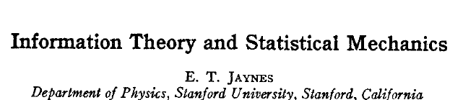
Cross over in vitro in vivo?
1957
Physics from Fisher information – Roy Frieden
Information through 2-d surfaces-holography
eg black body radiation, black hole horizon
Is the universe one big information processing machine?

Slide 21
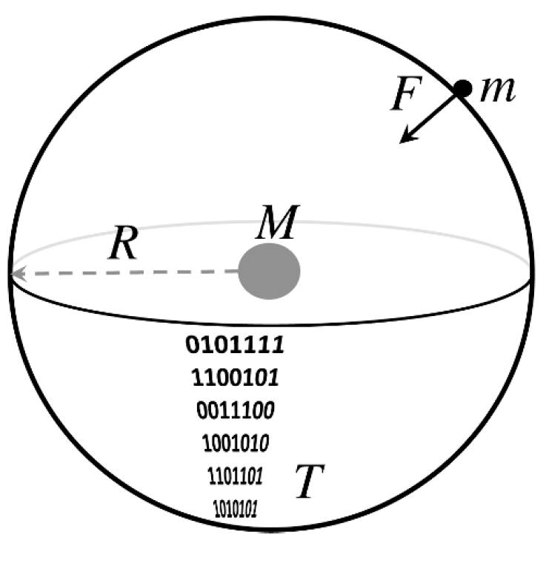
Newton’s law of gravity
Verlinde 2009- 2011
1) # Bits ~ area: N = area/area l_{h} = 4 π R² c³ /Gh
E = ½ NkT E = Mc² G=?
=> M = 2 π R² c kT / Gh
F = m a = G m M/R²
2) Acceleration ~ T : G=!
a = 2 π kT c / h
Unruh, elastic, holography

Slide 22
VeVerlinde 2016
connects to GR, black hole entropy, string
Derives the necessity entanglement of entropy obeying an area law
2011) Area law
2016) Volume law
Entanglement of entropy in volume
Placing matter-> elastic response (Sakharov- 1967)
Boundary of universe - Dark energy
Area / volume -> a₀ = cH -> “dark matter” scale

Slide 23
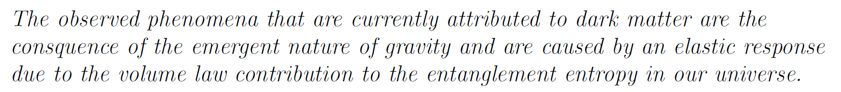
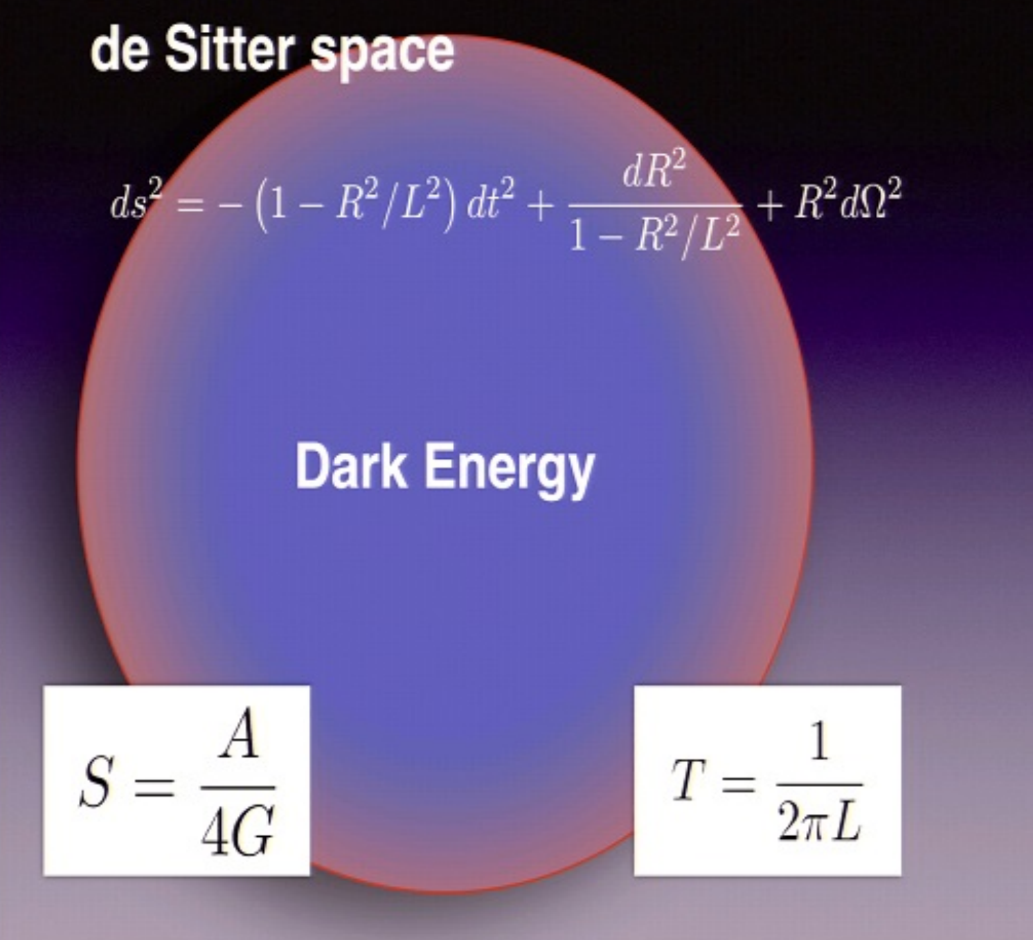
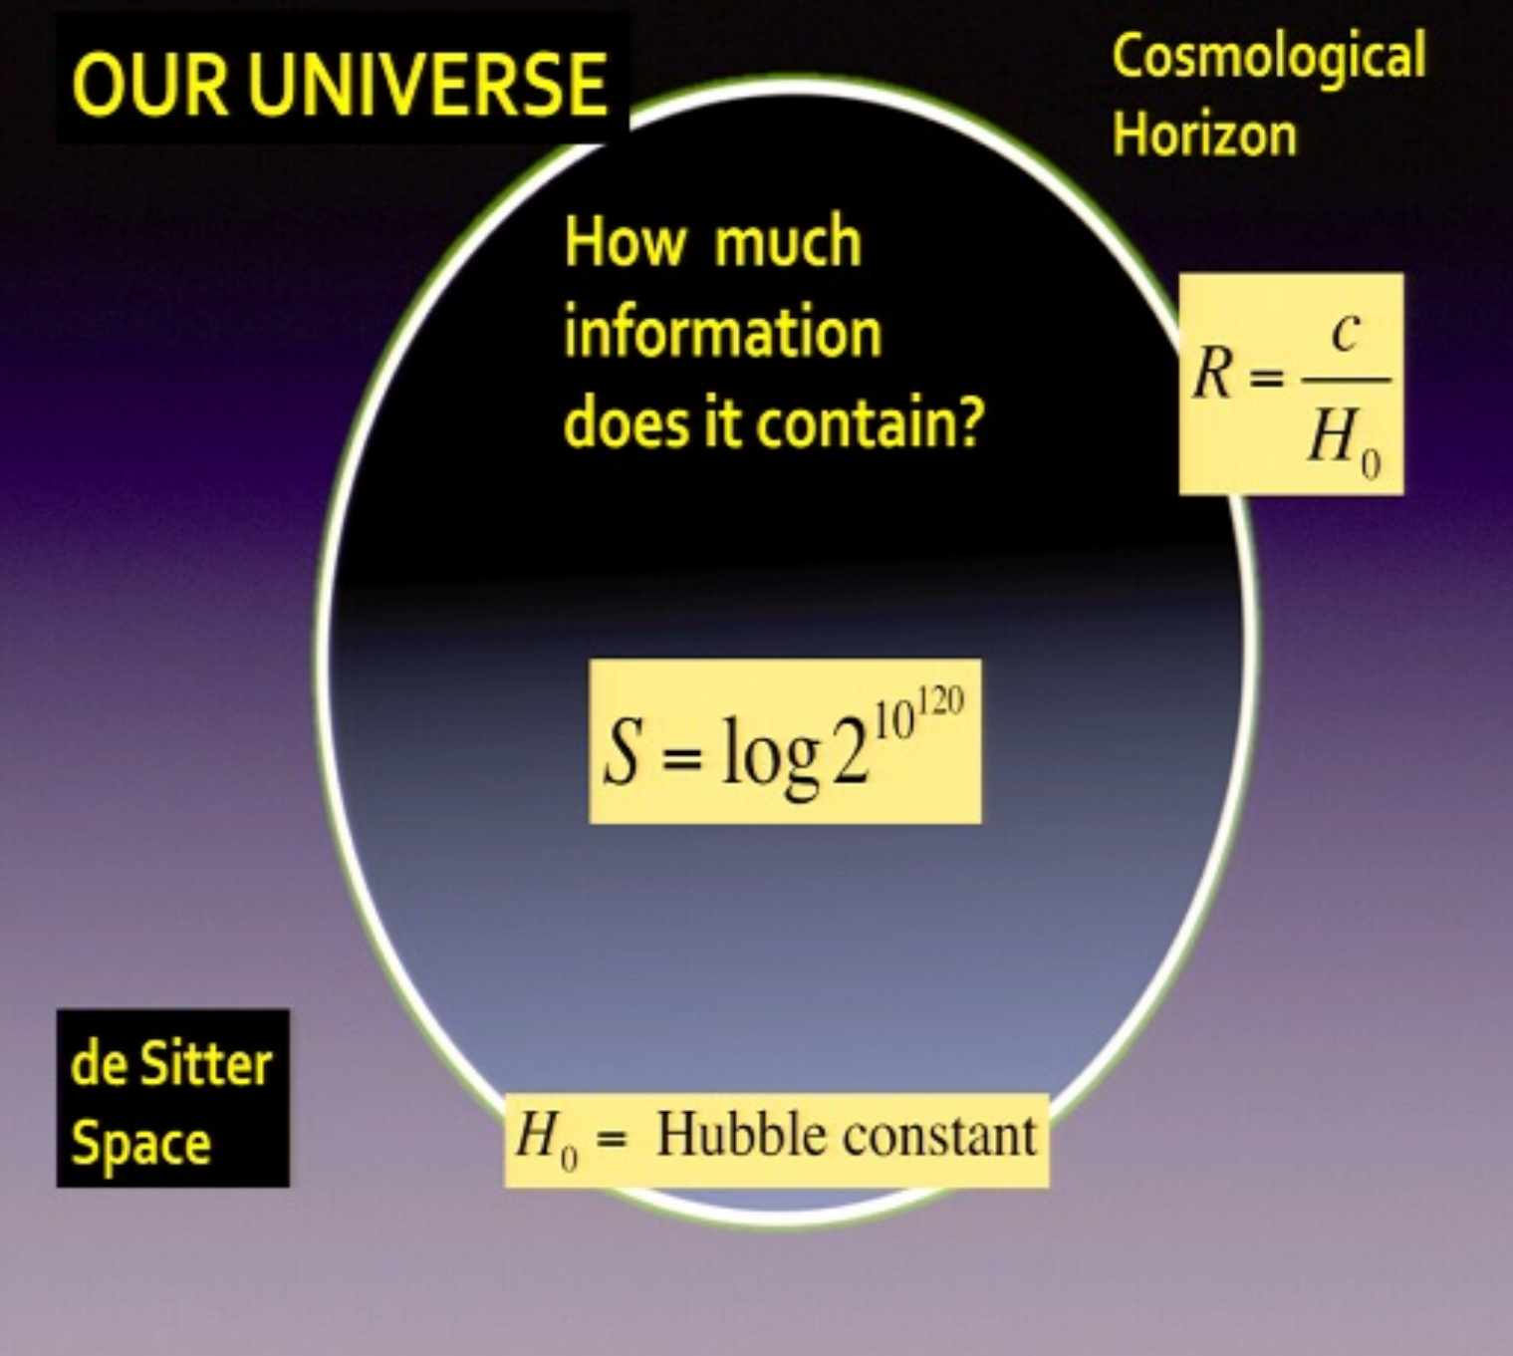
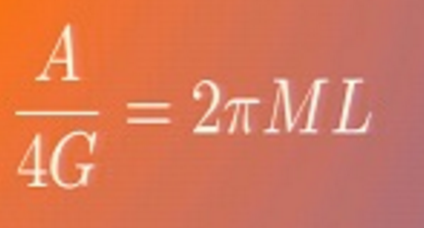
Graph from Verlinde
Bekenstein-Hawking black hole S
CMB 10⁹⁰
Dark Energy 10¹²⁰
very low T
H_{o}=c/L

Slide 24


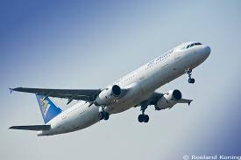
Information Universe – in vivo in vitro
bionic astroinformatics- the information universe
Entanglemant - data lineage- provenance
the way forward in astro informatics

Slide 25
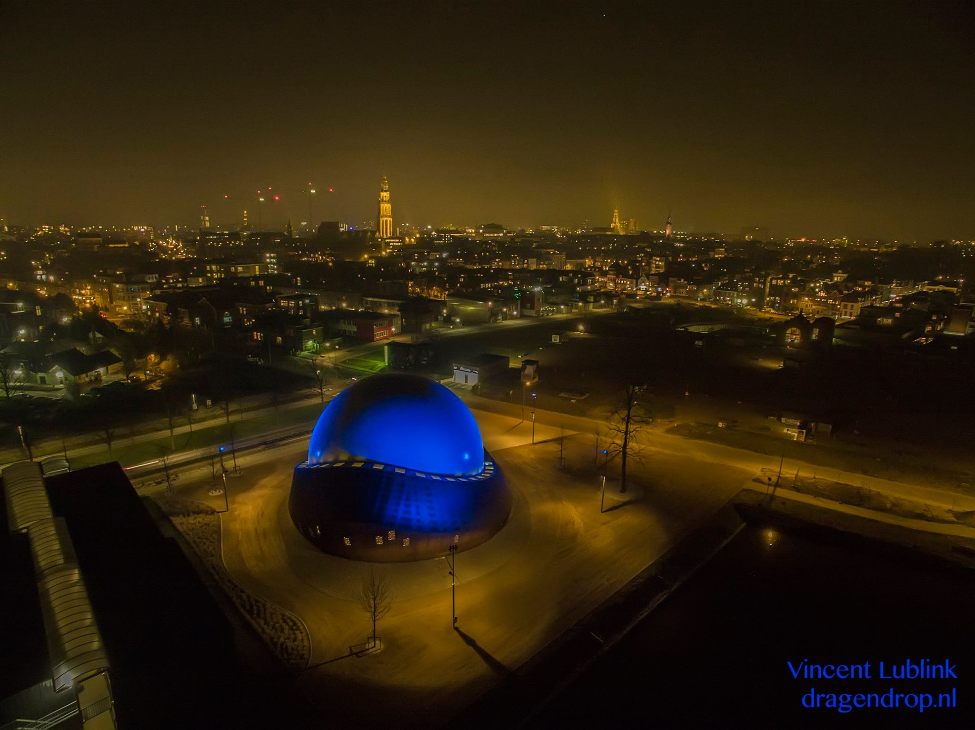
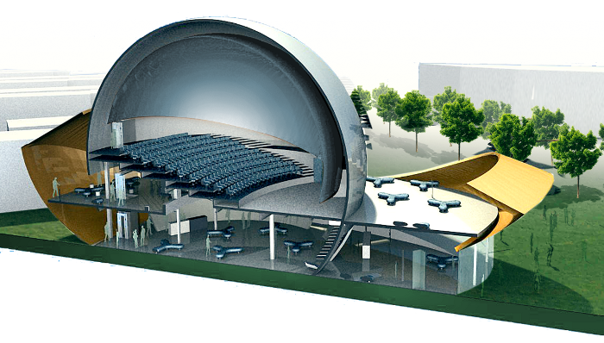

Slide 26
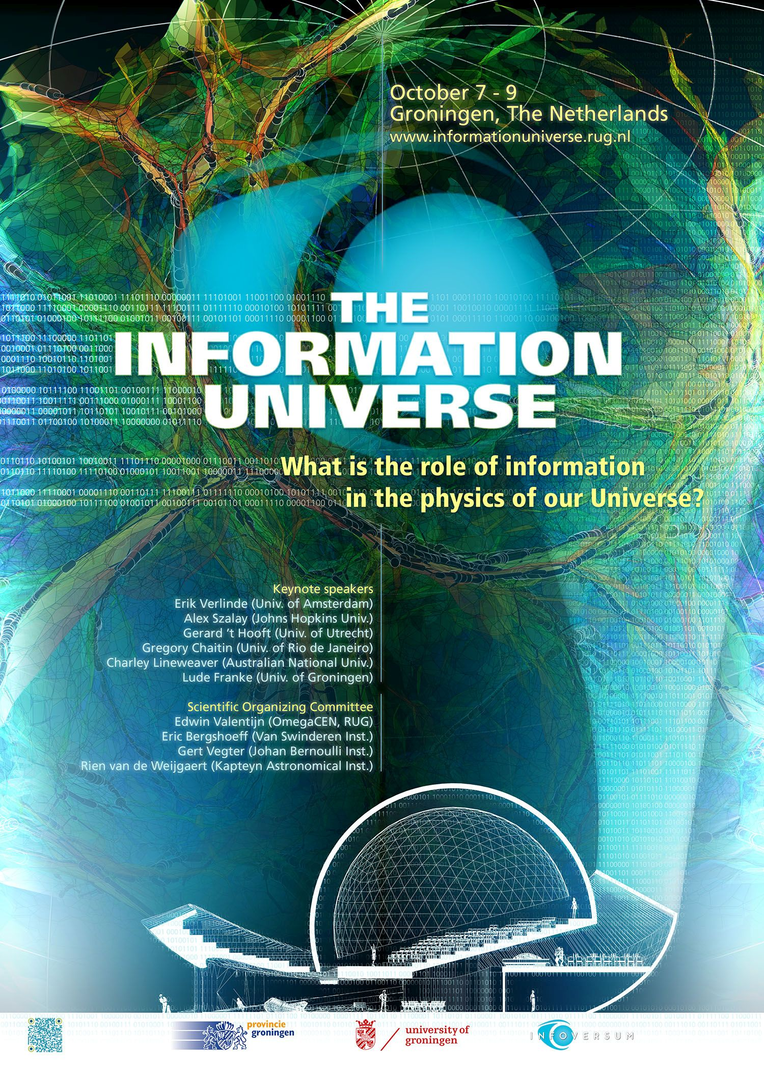
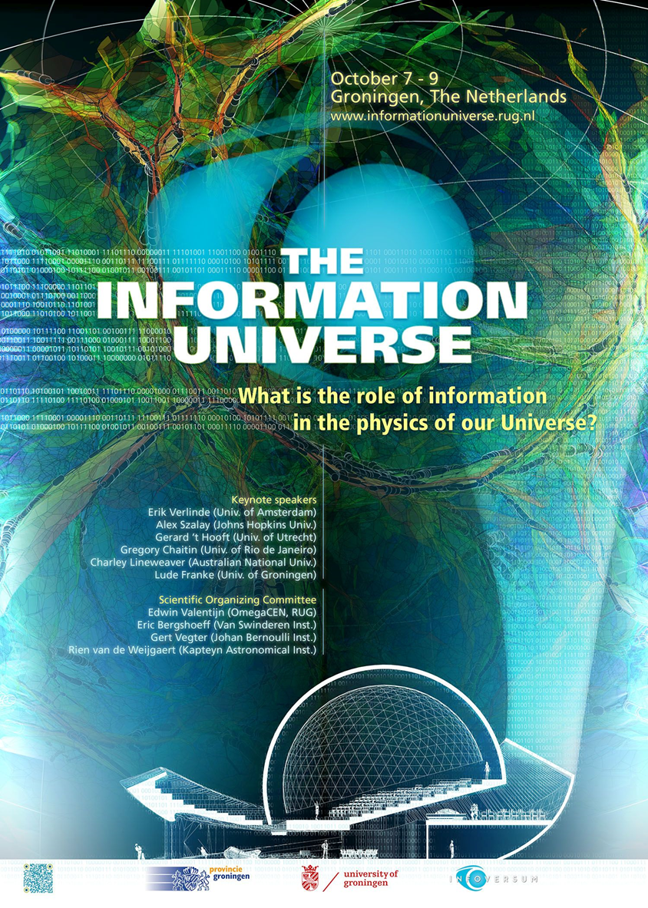
2015
Next IU conference 2018
Mail to:
informationuniverse@rug.nl

