Slide 1

CHAOUL Laurence, PANEM Chantal
CNES, Toulouse
Processing Gaia’s Billion Stars in CNES, a Big Data Story
EWASS 2017, June 29th 2017

Slide 2

The DPCC Key Numbers
Gaia DPCC = Gaia Data Processing Center in CNES
Up to 8 chains to be processed in parallel
    Spectroscopic chains
    Objects processing chains (Multiple Stars, Solar System Objects, Galaxy, Quasars)
    Astrophysical Parameters Determination chain
    Various kinds of complex algorithms (object by object or global processings)
Number of objects to process
    1 billion stars, 80 billions observations
    Increasing volume all along the mission, up to 4PB
Architecture built with a NoSql solution : Hadoop
    High Level of parallelization
    HDFS: distributed data storage

Slide 3


The first main lessons learned
    It works !
    High Performing Parallel Computing
    Able to handle tables with tens of billions records
    Very scalable
    Hadoop configuration very tricky
    No indexing capabilities : difficult to request the content of the tables => problem for validating the results
    The scientific algorithms shall be designed to be run in parallel
Proven architecture for Gaia DR2 processings
and on the right track for Gaia DR3 !

Slide 4
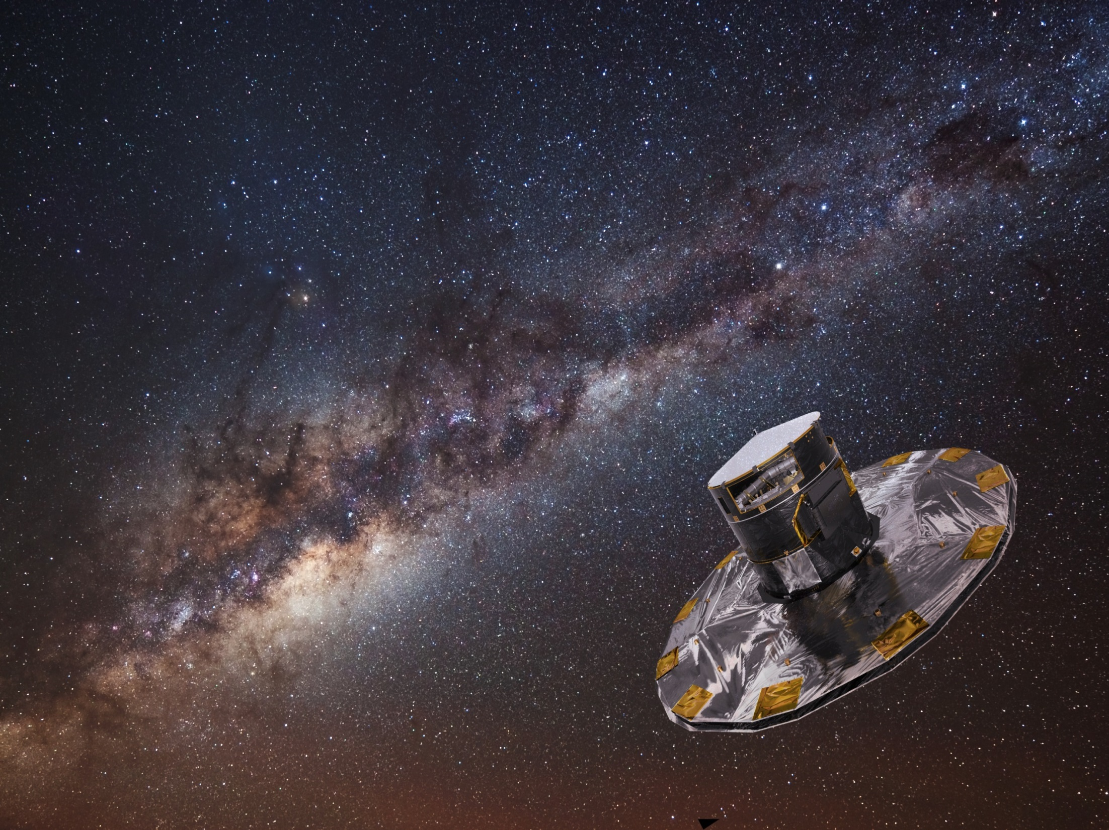
More info ?
  http://www.cosmos.esa.int/web/gaia/
  http://smsc.cnes.fr/GAIA/
  laurence.chaoul@cnes.fr

